Slide 1


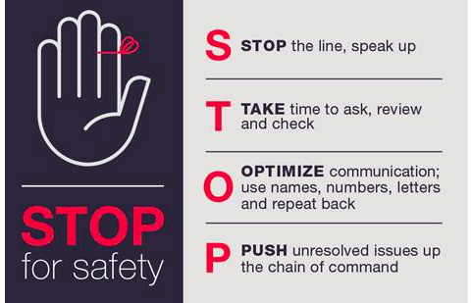
Hand Hygiene
Hospital Epidemiology & Infection Control
OBSERVER TRAINING
Updated: FY2018
Notes:
11/29/17 Reviewed, updated

Slide 2
This Course Addresses UCSF Hand Hygiene Standards:
Hand Hygiene Policy
Hand Hygiene Observation Standards
Hand Hygiene Observation Tool
Data Entry
Corrective Action
Hand Hygiene Observer Test
Notes:
11/29/17 Reviewed, updated
Text:
This training will cover six areas that you, as the Hand Hygiene Observer need to know.

Slide 3
Hand Hygiene Policy
Notes:
11/29/17 Reviewed, updated

Slide 4
Hand Hygiene Policy Requirements
One must clean one’s hands:
  Before touching a patient
  Before a clean/aseptic procedure
  After body fluid exposure
  After touching a patient
  After touching patient surroundings
  Additional hand hygiene indications
    Before preparing food
    After using the restroom
    After touching one’s face, nose or hair or personal device (e.g. pager, phone)
Notes:
11/29/17 Reviewed, updated

Slide 5
Hand Hygiene Policy Requirements
Use Alcohol-Based Hand Rub (ABHR) for non-visibly soiled hands:
  Before and after gloving
  Upon entry to Enteric Contact Isolation
Use Soap-and-water wash:
  Before eating or preparing food
  After toileting
  Upon exit from Enteric Contact Isolation
Use Surgical Scrub:
  Prior to performing surgery
Notes:
11/29/17 Reviewed, updated
Refer to the Hand Hygiene Policy, IC 1.2 http://infectioncontrol.ucsfmedicalcenter.org/sites/infectioncontrol.ucsfmedicalcenter.org/files/Sec%201%202%20Hand%20Hygiene%20Policy.pdf

Slide 6

Hand Hygiene Policy Requirements
Thresholds mark entry into a patient care space, such as:
  Door sweeps
  Sliding doors
  Privacy curtains
Crossing the threshold = Hand Hygiene Opportunity
  You must clean your hands when crossing a threshold

Slide 7
Hand Hygiene Observation Standards
Notes:
11/29/17 Reviewed, updated

Slide 8
Hand Hygiene Observation Standards
Thresholds
30 second rule
Hands Full guidance
Specialty guidance
Enteric Contact Isolation
Putting on and taking off PPE

Slide 9
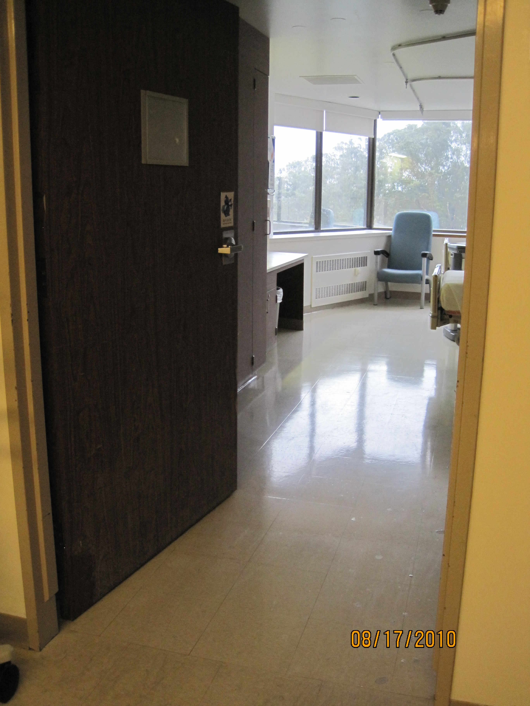
Acute Care Patient Room
No Hand Hygiene needed standing in the door sweep (threshold)
Hand Hygiene required
DOOR SWEEP = threshold

Slide 10
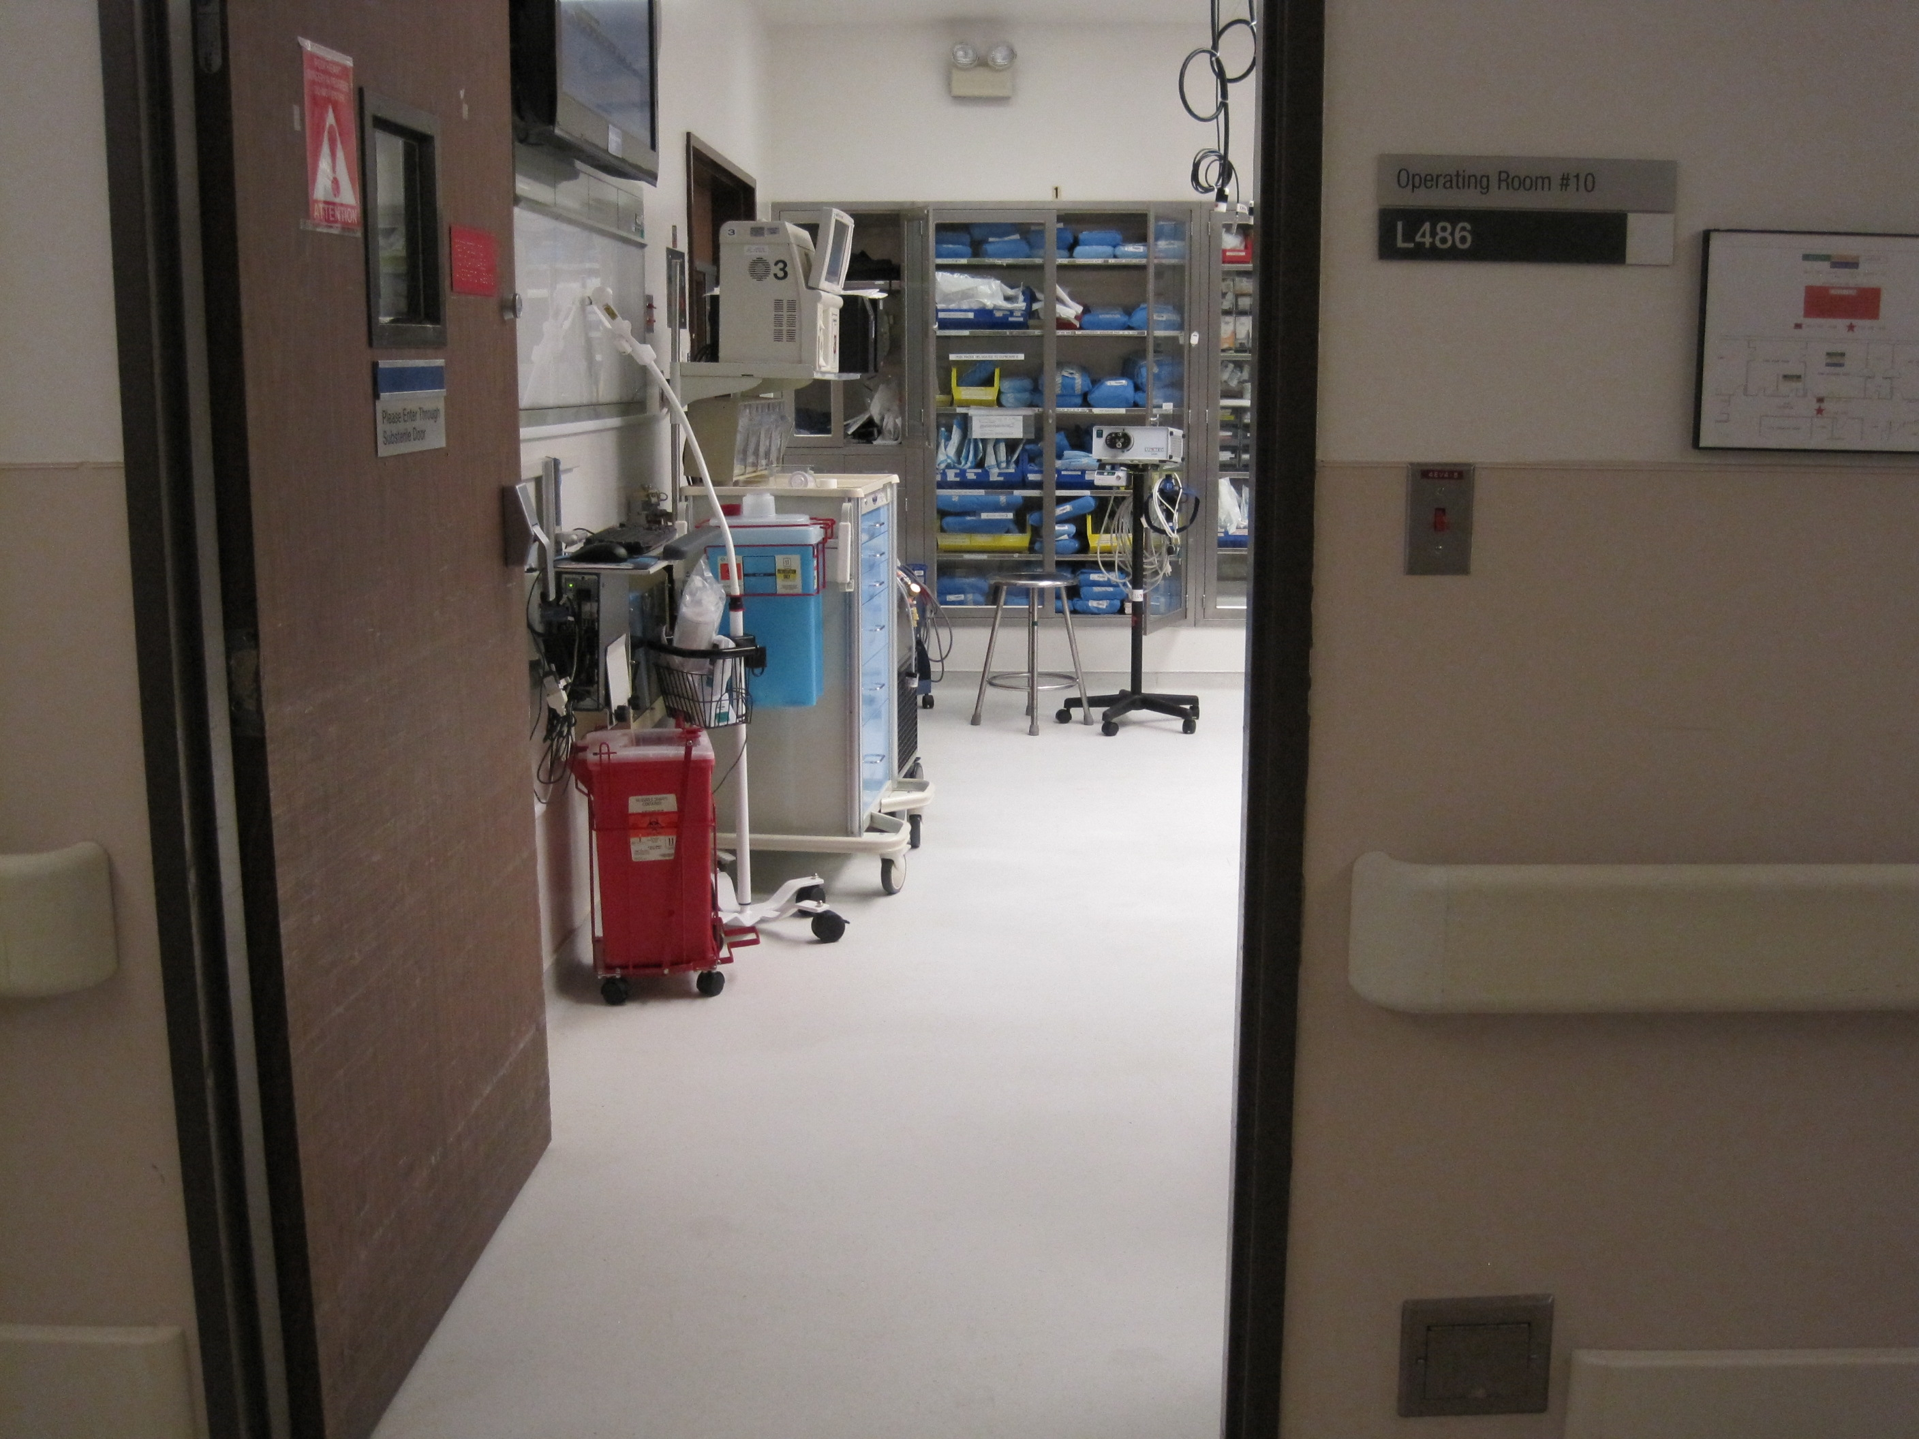
Operating/Procedure Room
Hand Hygiene required across door sweep (threshold)
No Hand Hygiene required

Slide 11
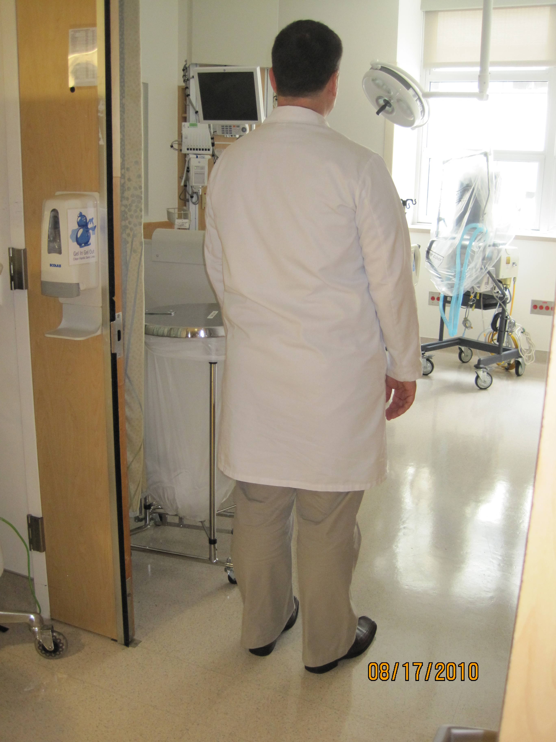
Critical Care Patient Room
HAND HYGIENE REQUIRED!
BOTH FEET ARE PAST THE THRESHOLD
THRESHOLD

Slide 12
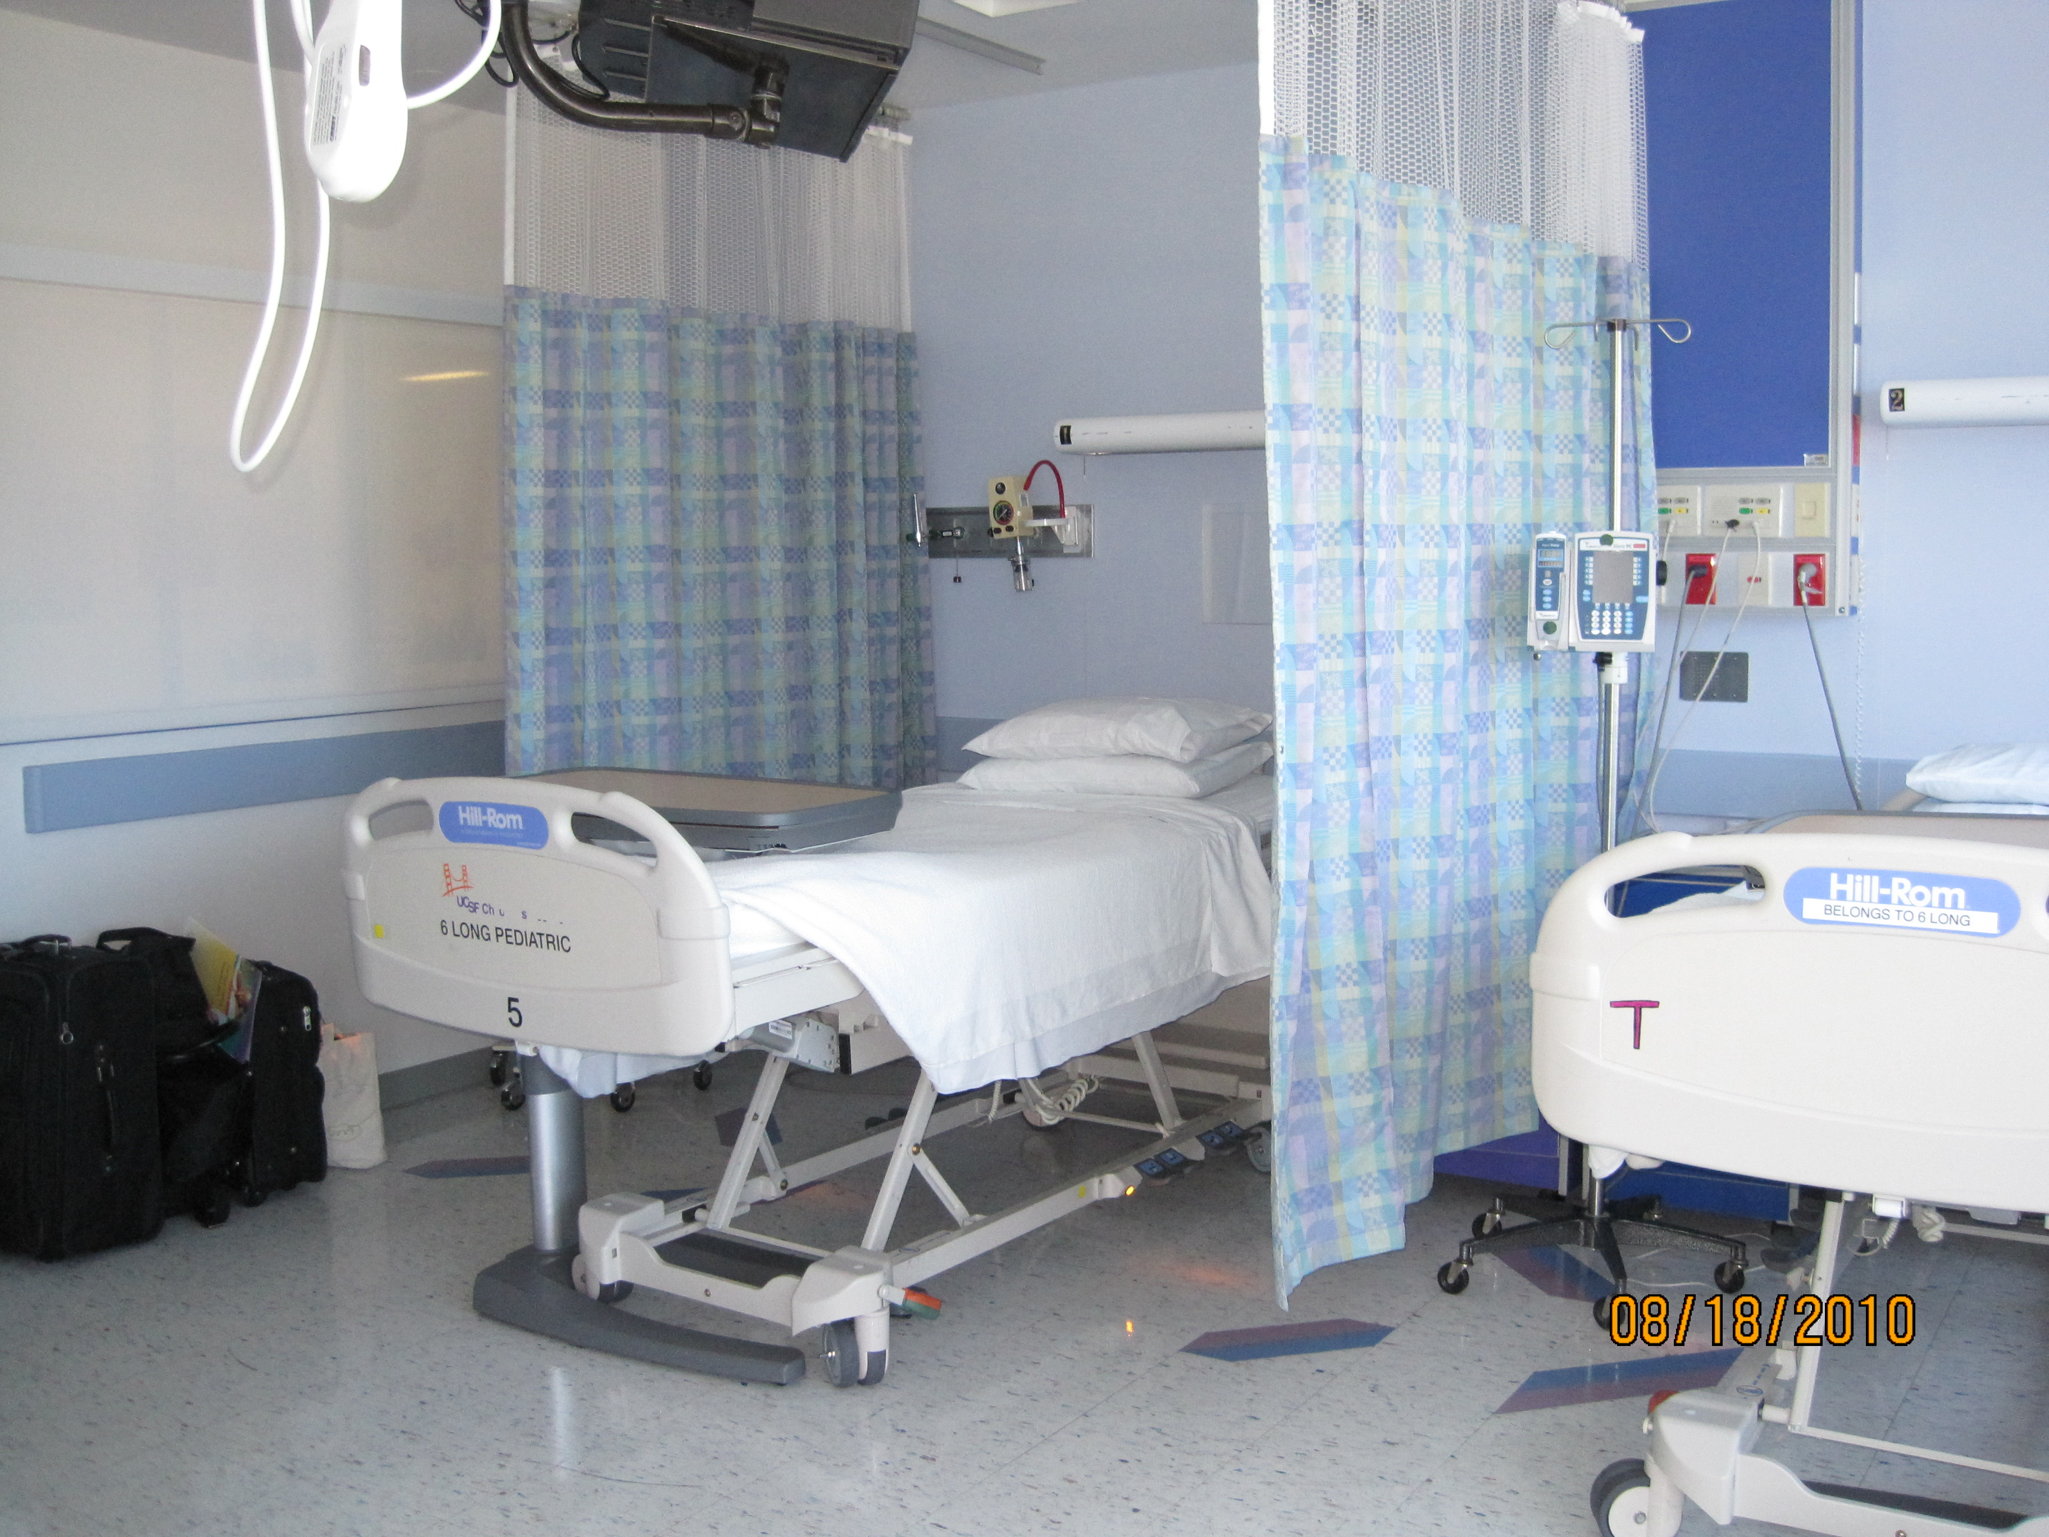
Acute Care Dual Occupancy Room
Patient 2
Patient 1

Slide 13
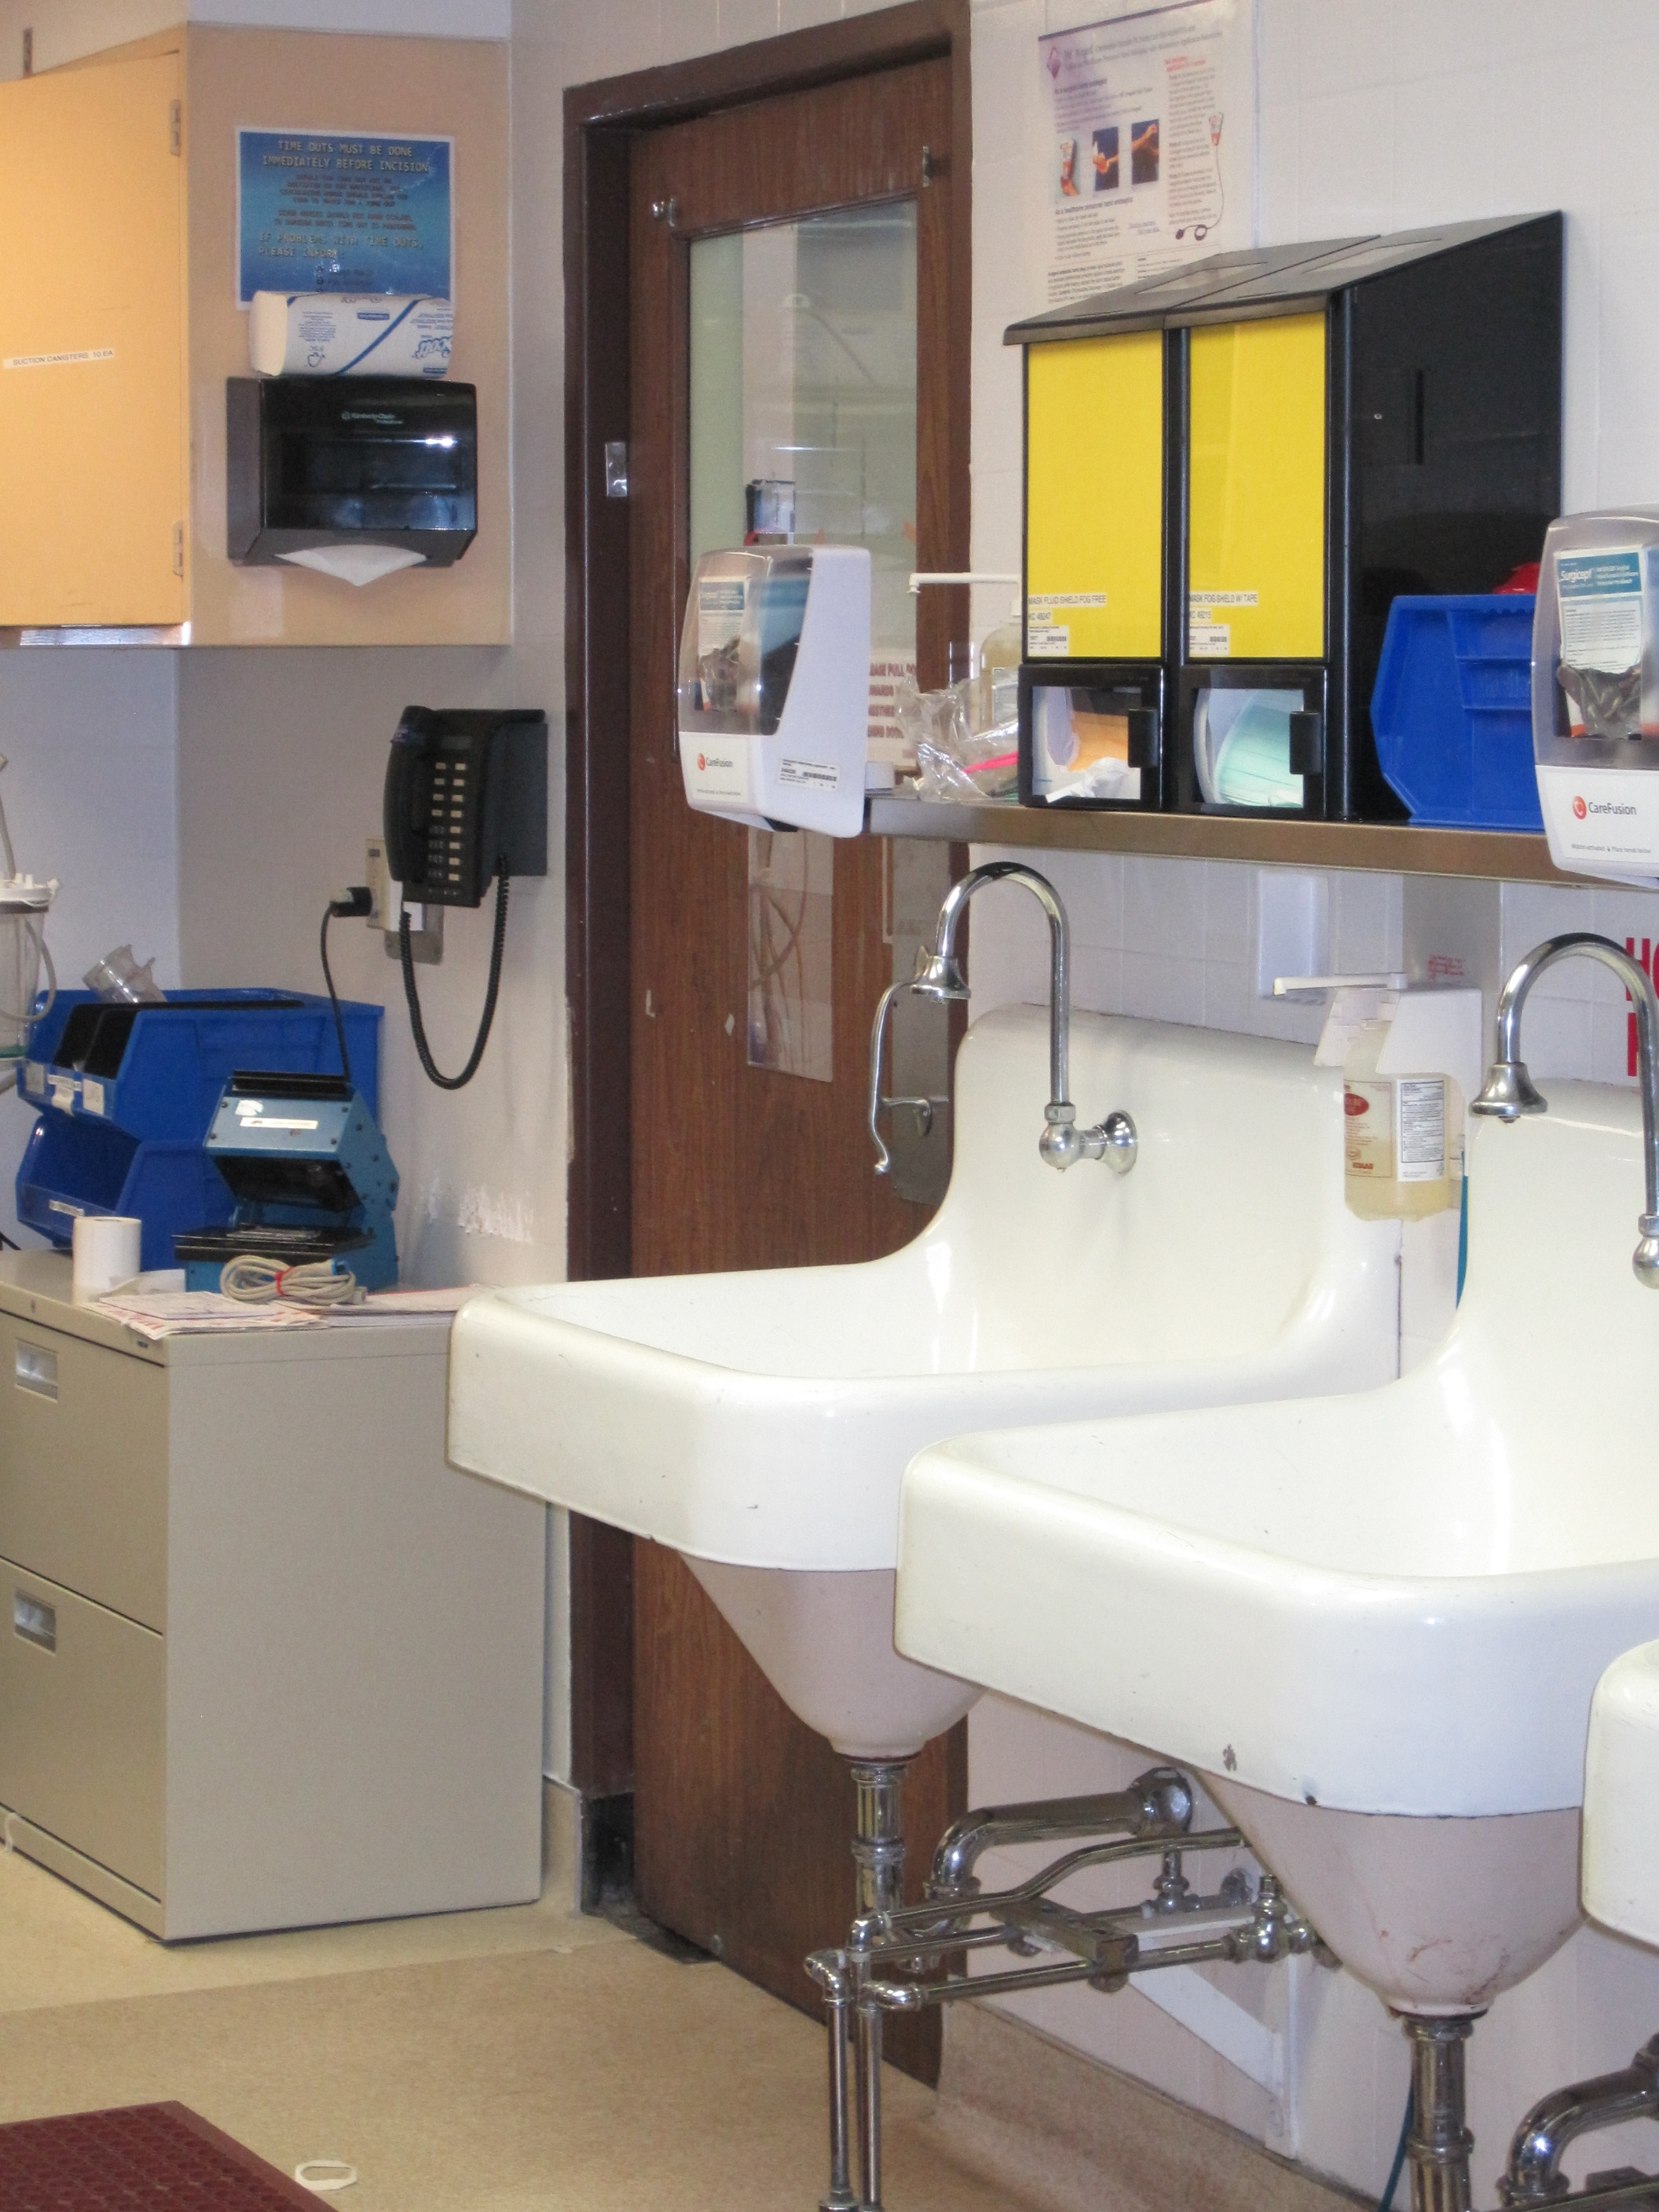
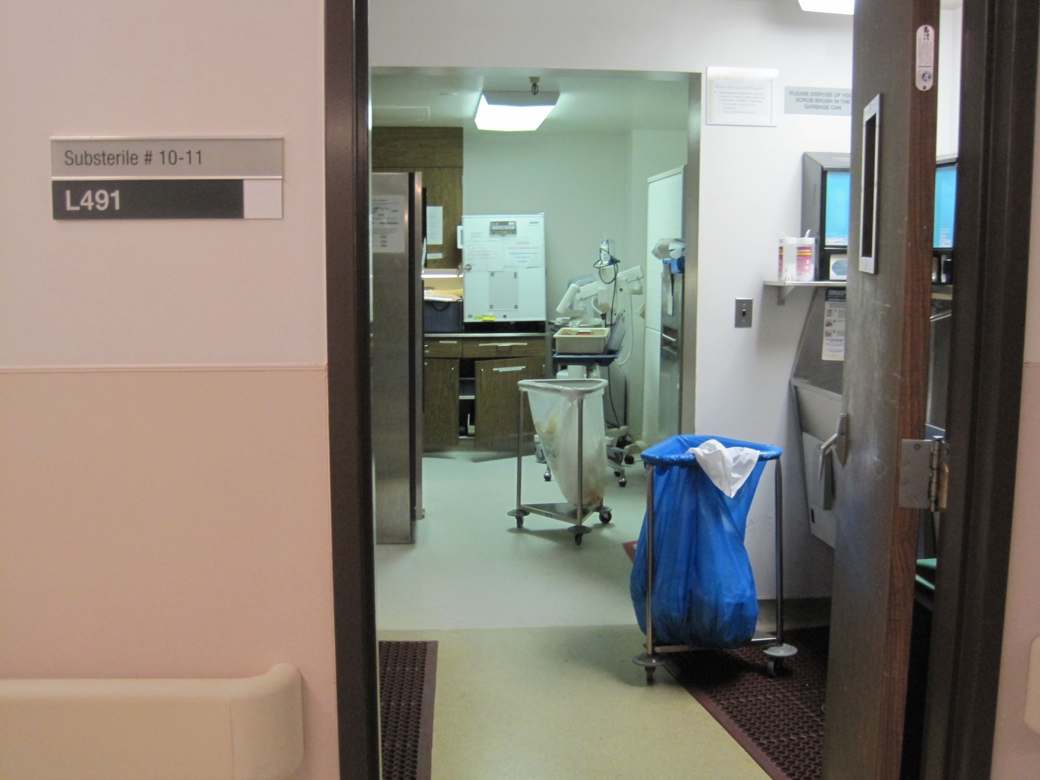
Operating/Procedure Room
Use ABHR when exiting one OR space before crossing the substerile area or hall.
If crossing another threshold within 30 seconds without touching anything, one hand hygiene activity counts as a compliant exit and entry.
If crossing another threshold takes longer than 30 seconds, or one has touched anything, one must clean hands again upon entry.

Slide 14
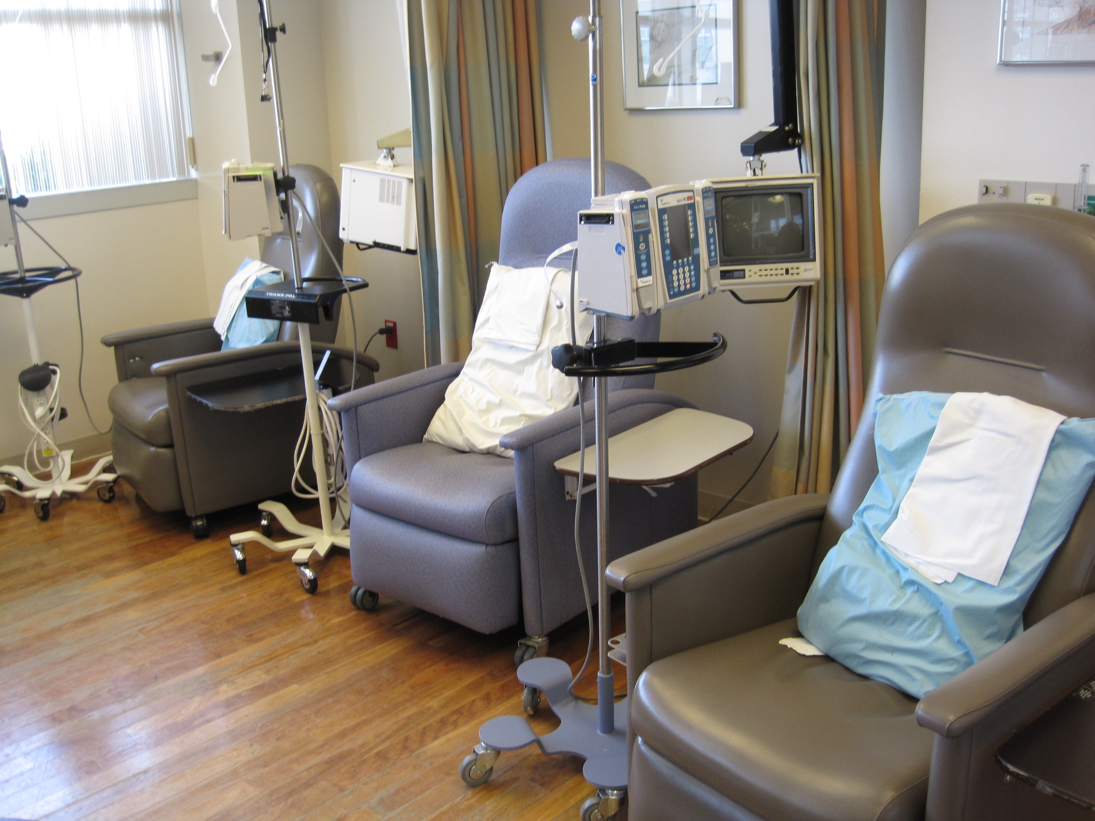
Curtain track is a threshold.
Hand hygiene-out counts as hand
hygiene-in when crossing
a curtain or door threshold when the
exit-entry occurs within 30 seconds

Slide 15
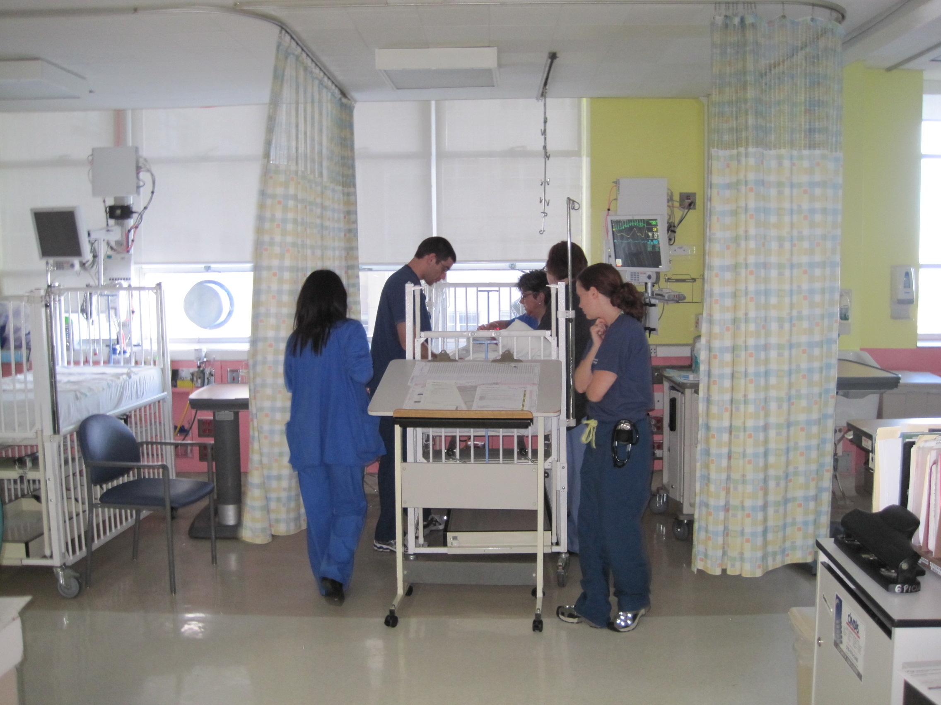
PRIVACY CURTAIN & CURTAIN TRACK = THRESHOLD
HAND HYGIENE REQUIRED
PUBLIC SPACE, NO HAND HYGIENE REQUIRED

Slide 16
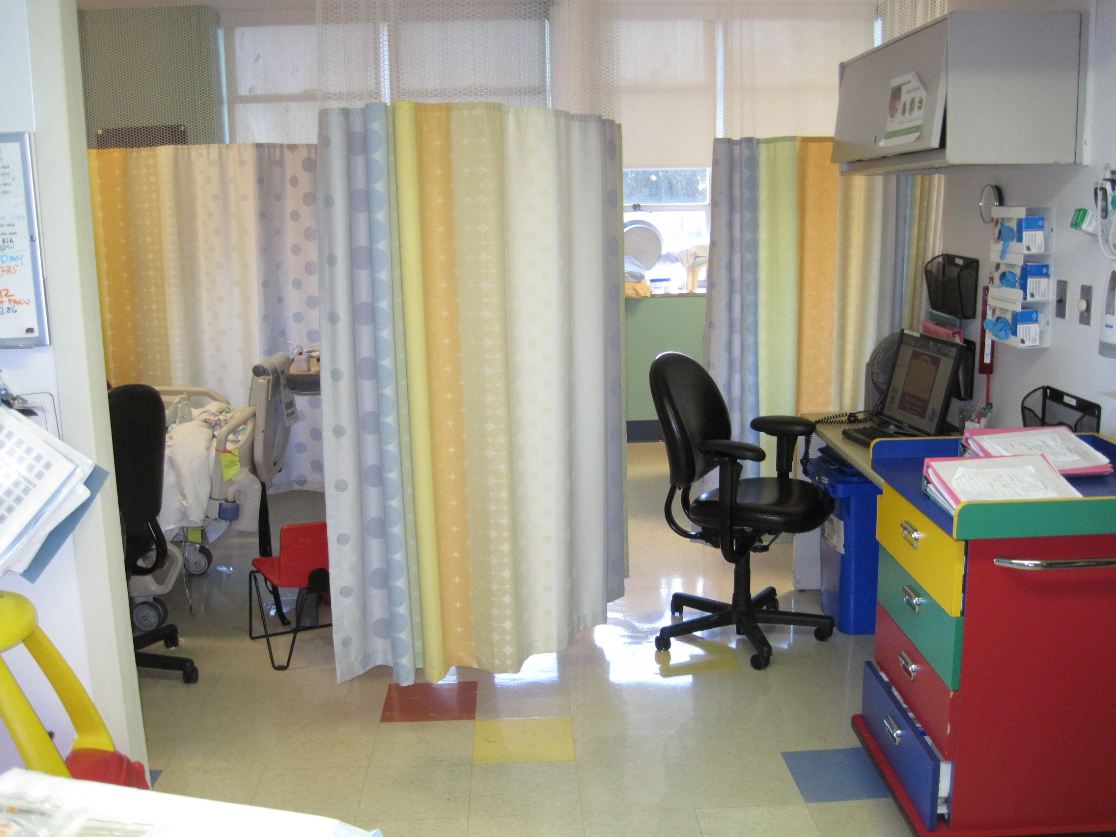
Curtain Track=Threshold
Hand Hygiene Required
Public Space
No Hand Hygiene Required

Slide 17
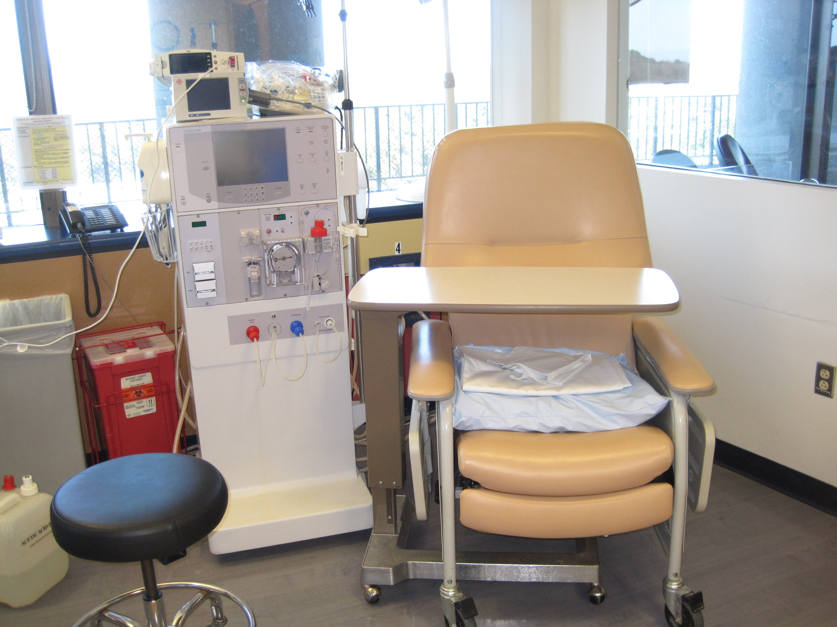
Virtual Threshold
Hand Hygiene is required when
entering and exiting across threshold

Slide 18
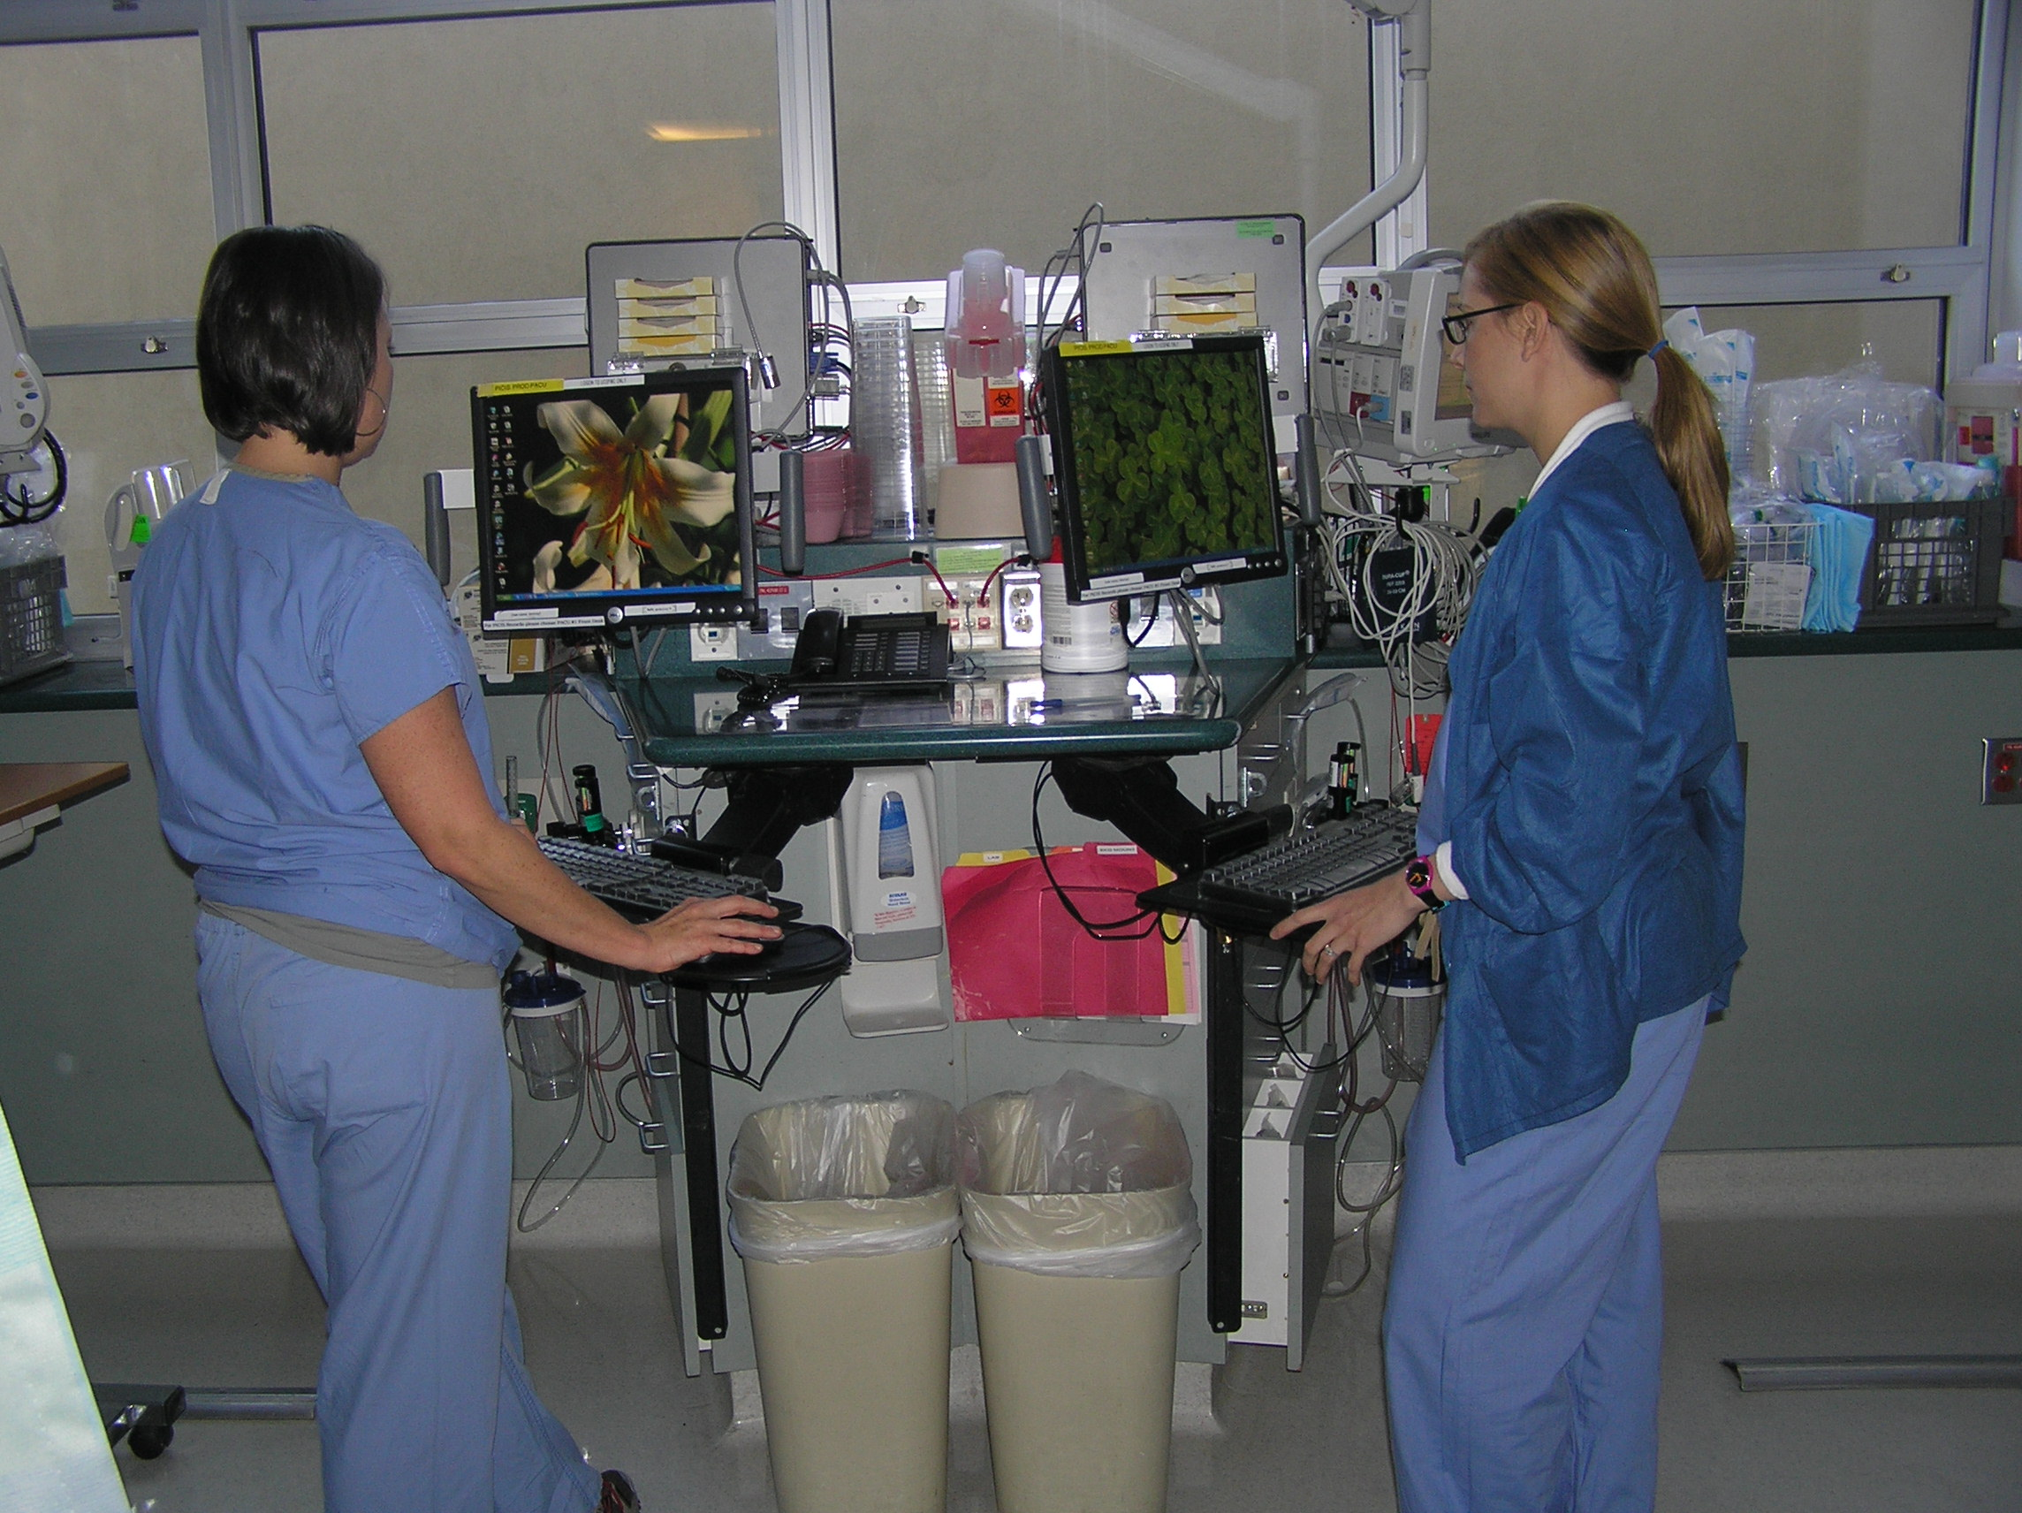
Zone Threshold
Zone 2
Zone 1
1. Patient, gurney, and all equipment associated with the patient = Zone.
2. Perform hand hygiene each time you cross a threshold in or out of a Zone.
3. HH “Out” of one zone counts as HH “In” to next zone when enter/exit occurs
within 30 seconds
4. Curtain track = Zone boundary at foot of gurney

Slide 19
30-Second Rule
Crossing two thresholds within 30 seconds without touching anything counts as two compliant opportunities
  Use ABHR upon exit from one patient room and enter another patient room
  Wash hands in one patient cubicle, cross the curtain track to enter the second patient cubicle.
  Use ABHR upon exit from one patient zone to another

Slide 20
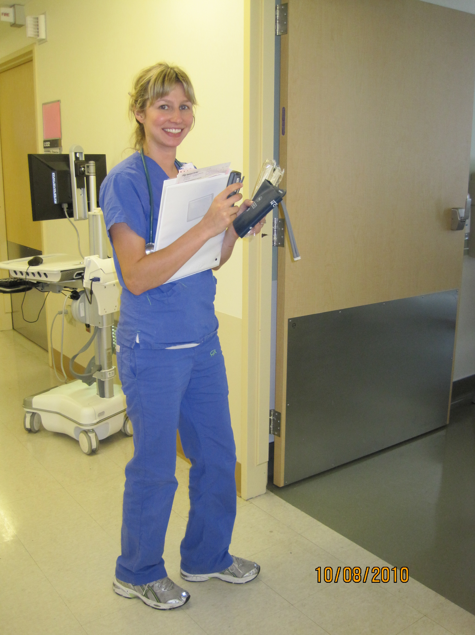
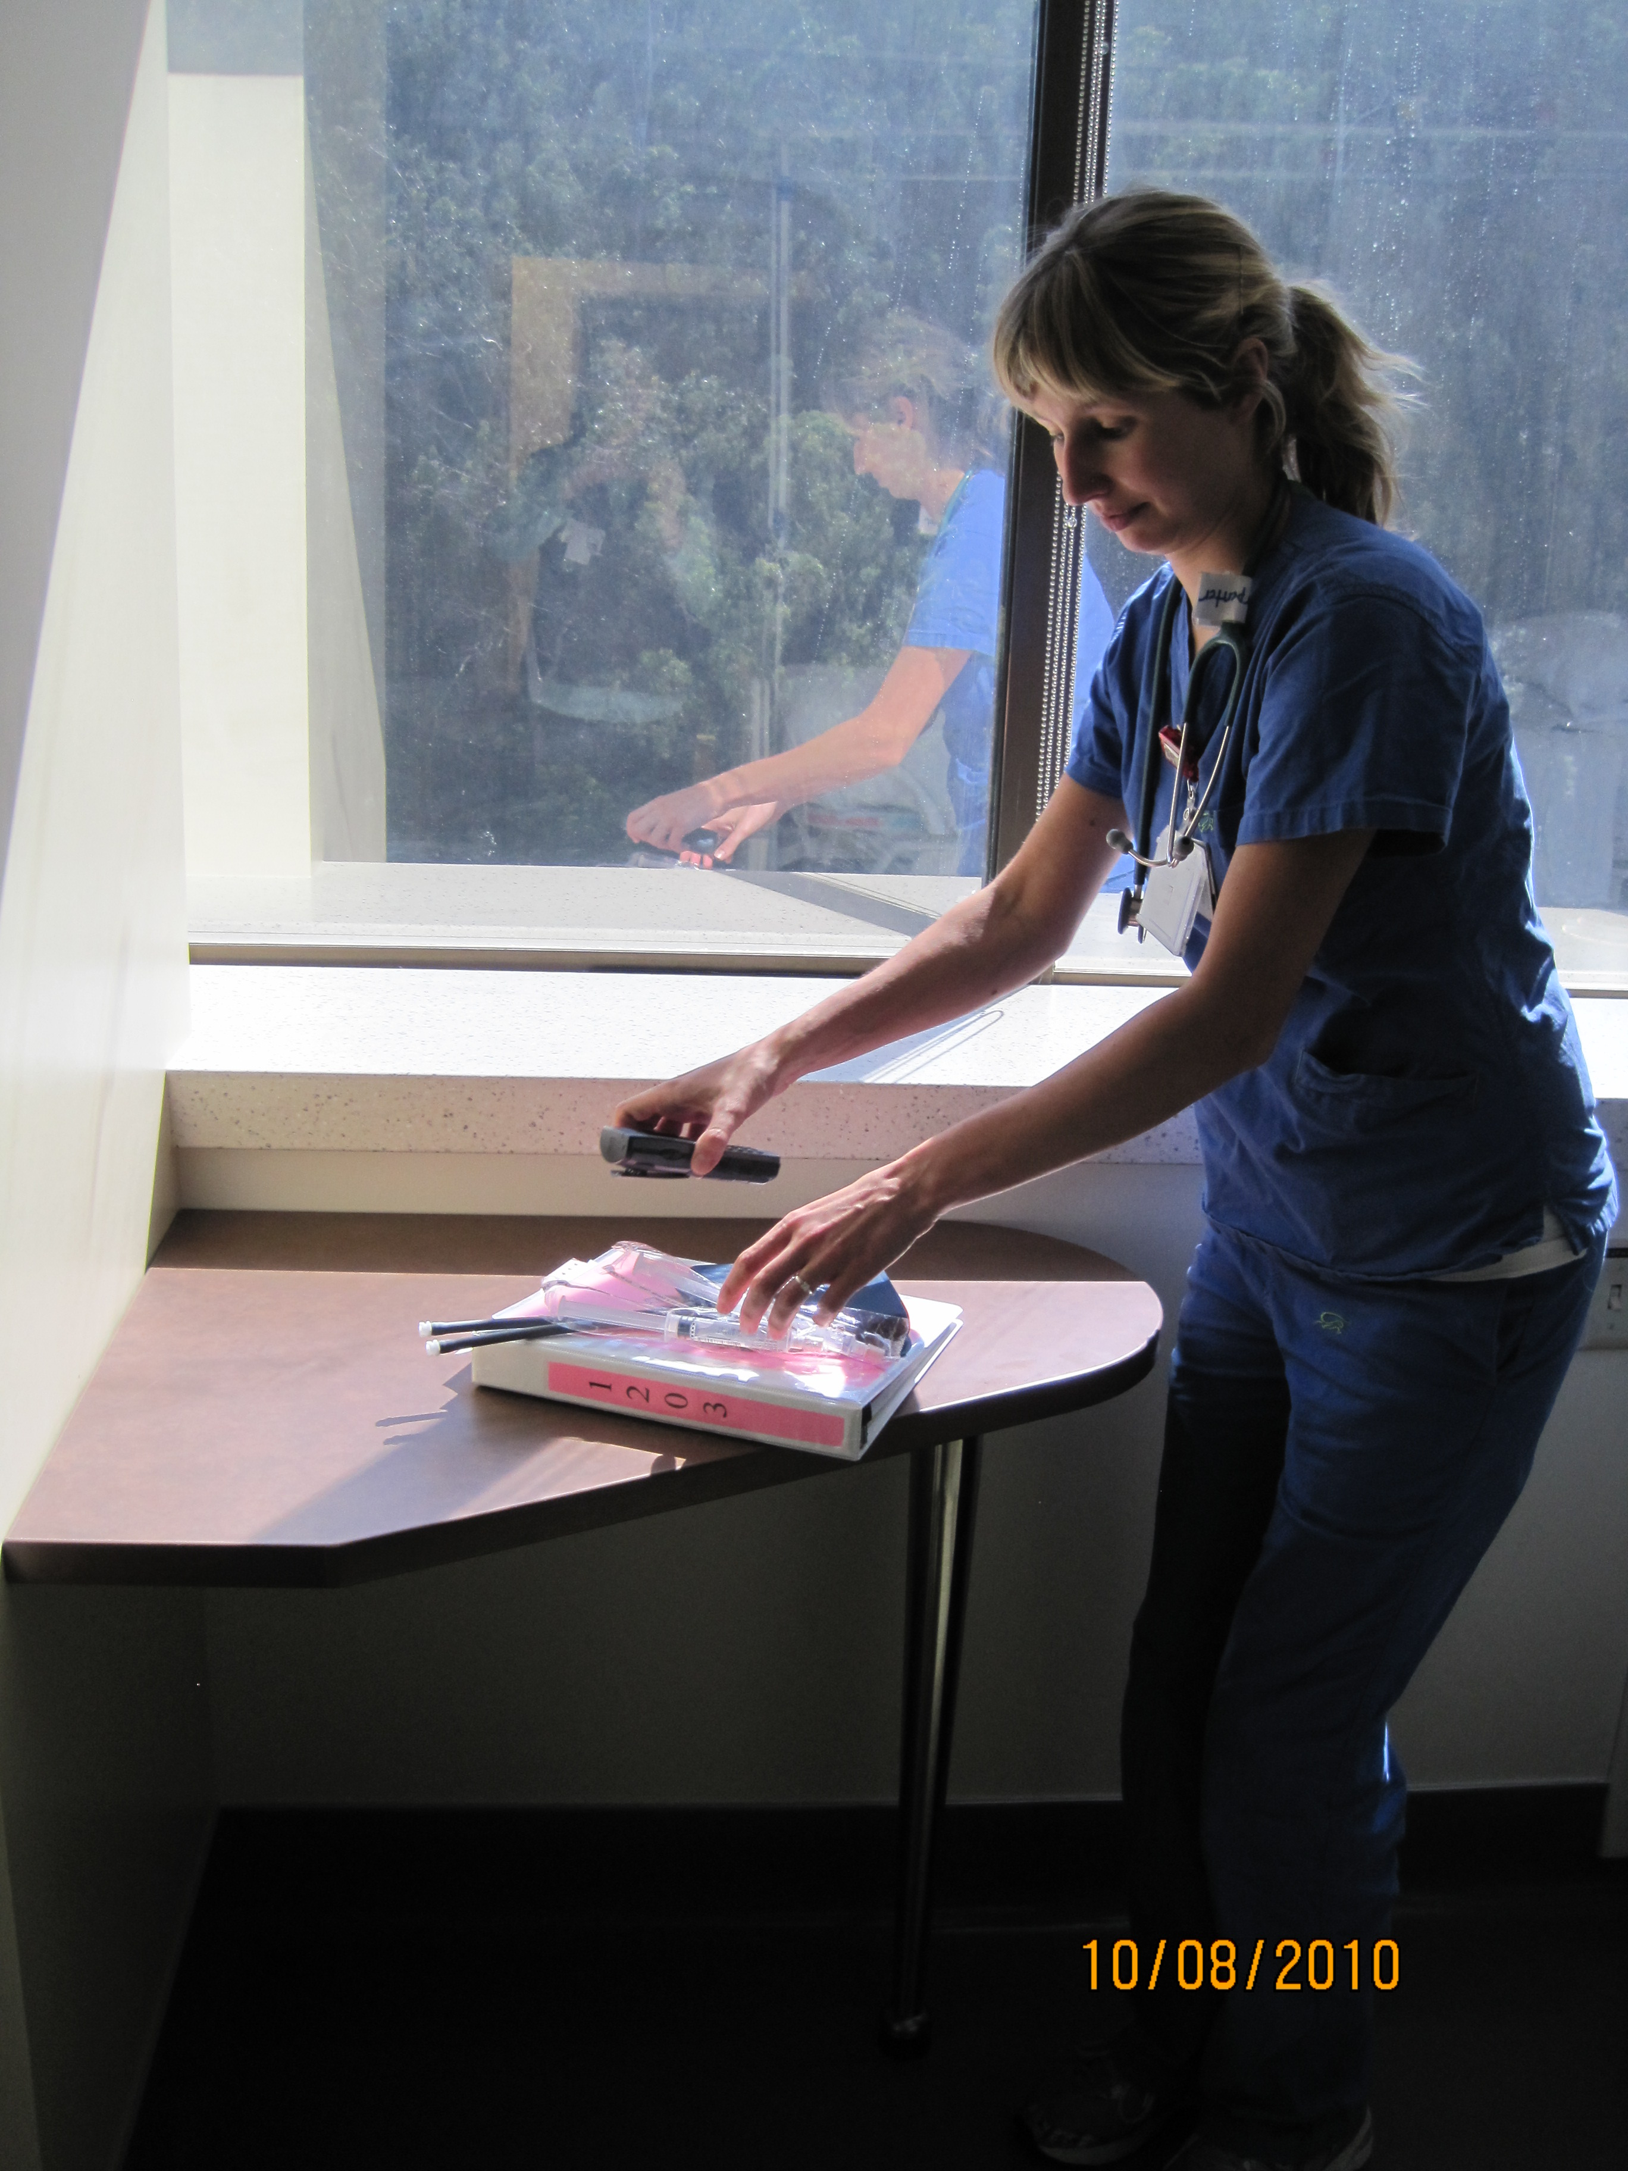
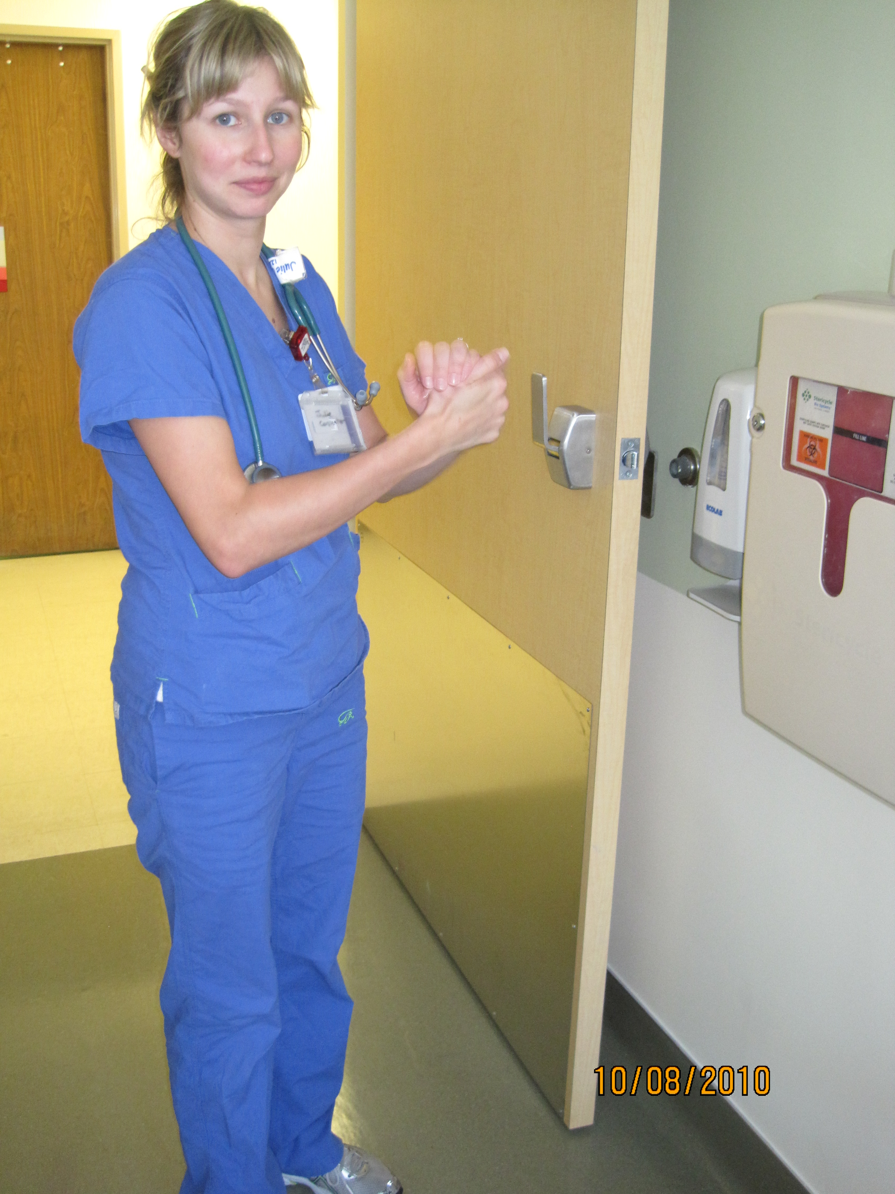
Hands Full Guidance (1)
Enter room with hands full
Place items in room
Clean hands

Slide 21
Hands Full Guidance (2)
Exit room with hands full
Place items in appropriate location
Clean hands

Slide 22
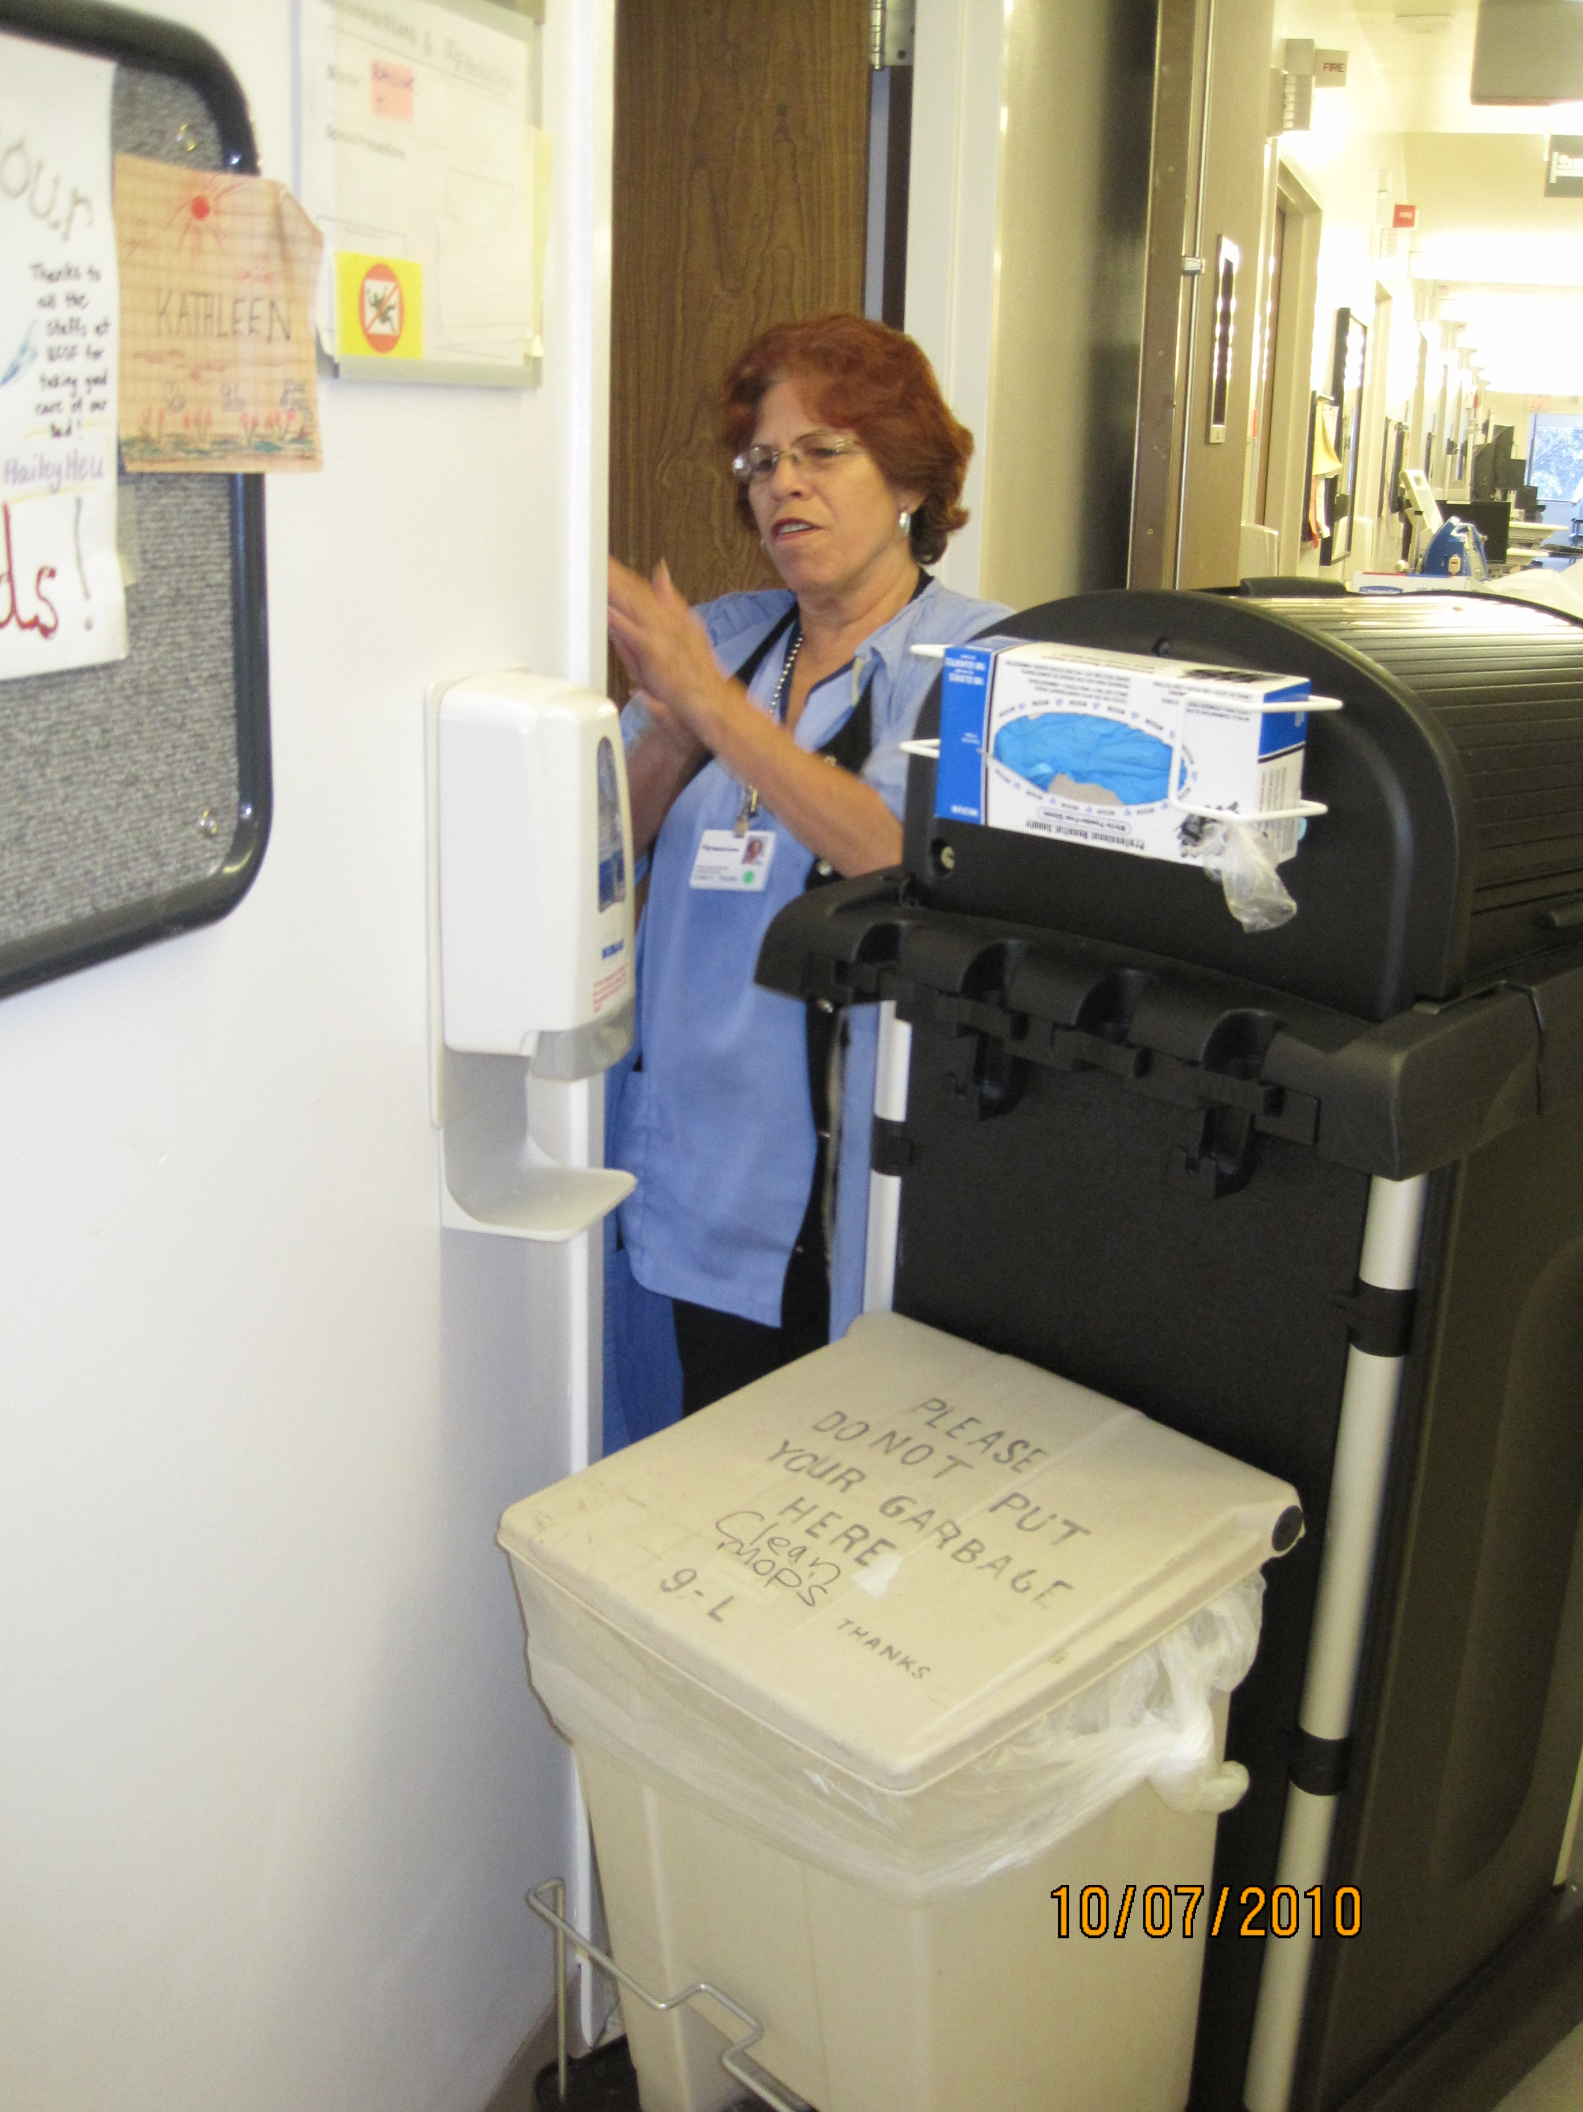
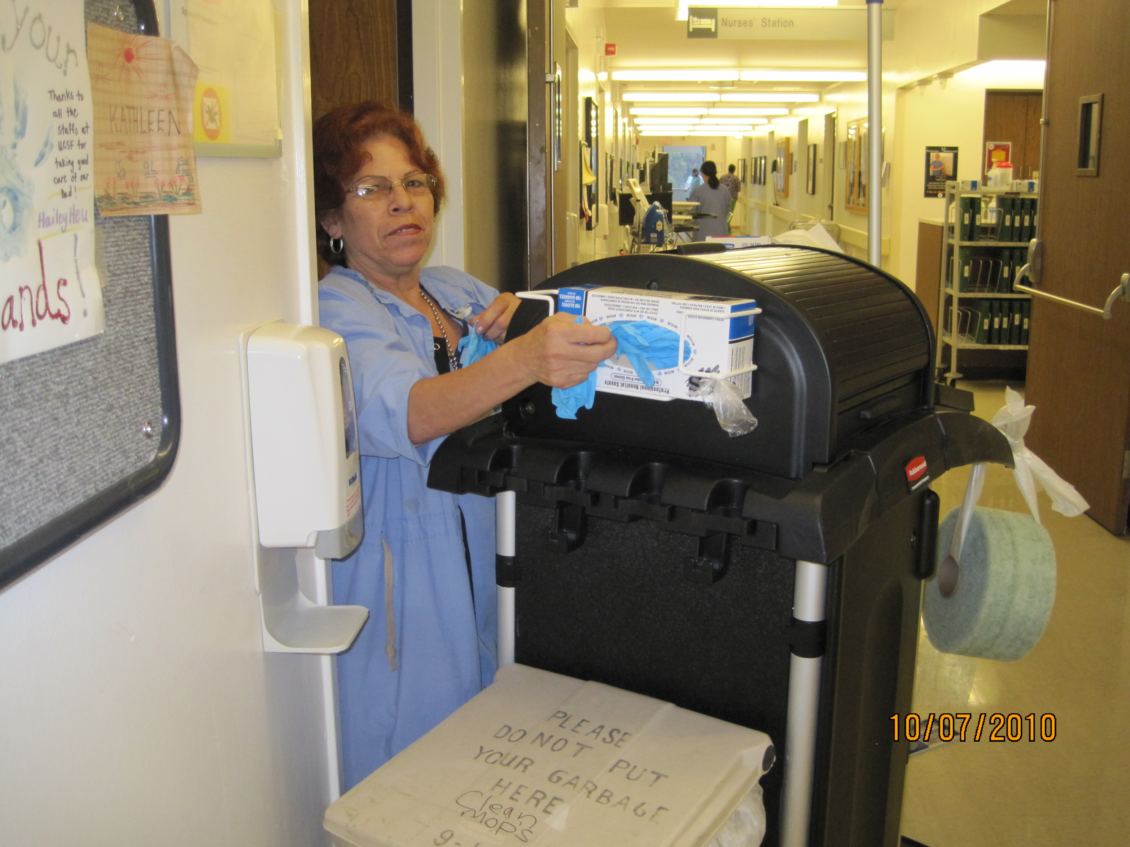
Hospitality (1)
Clean hands
Put on gloves to clean area

Slide 23
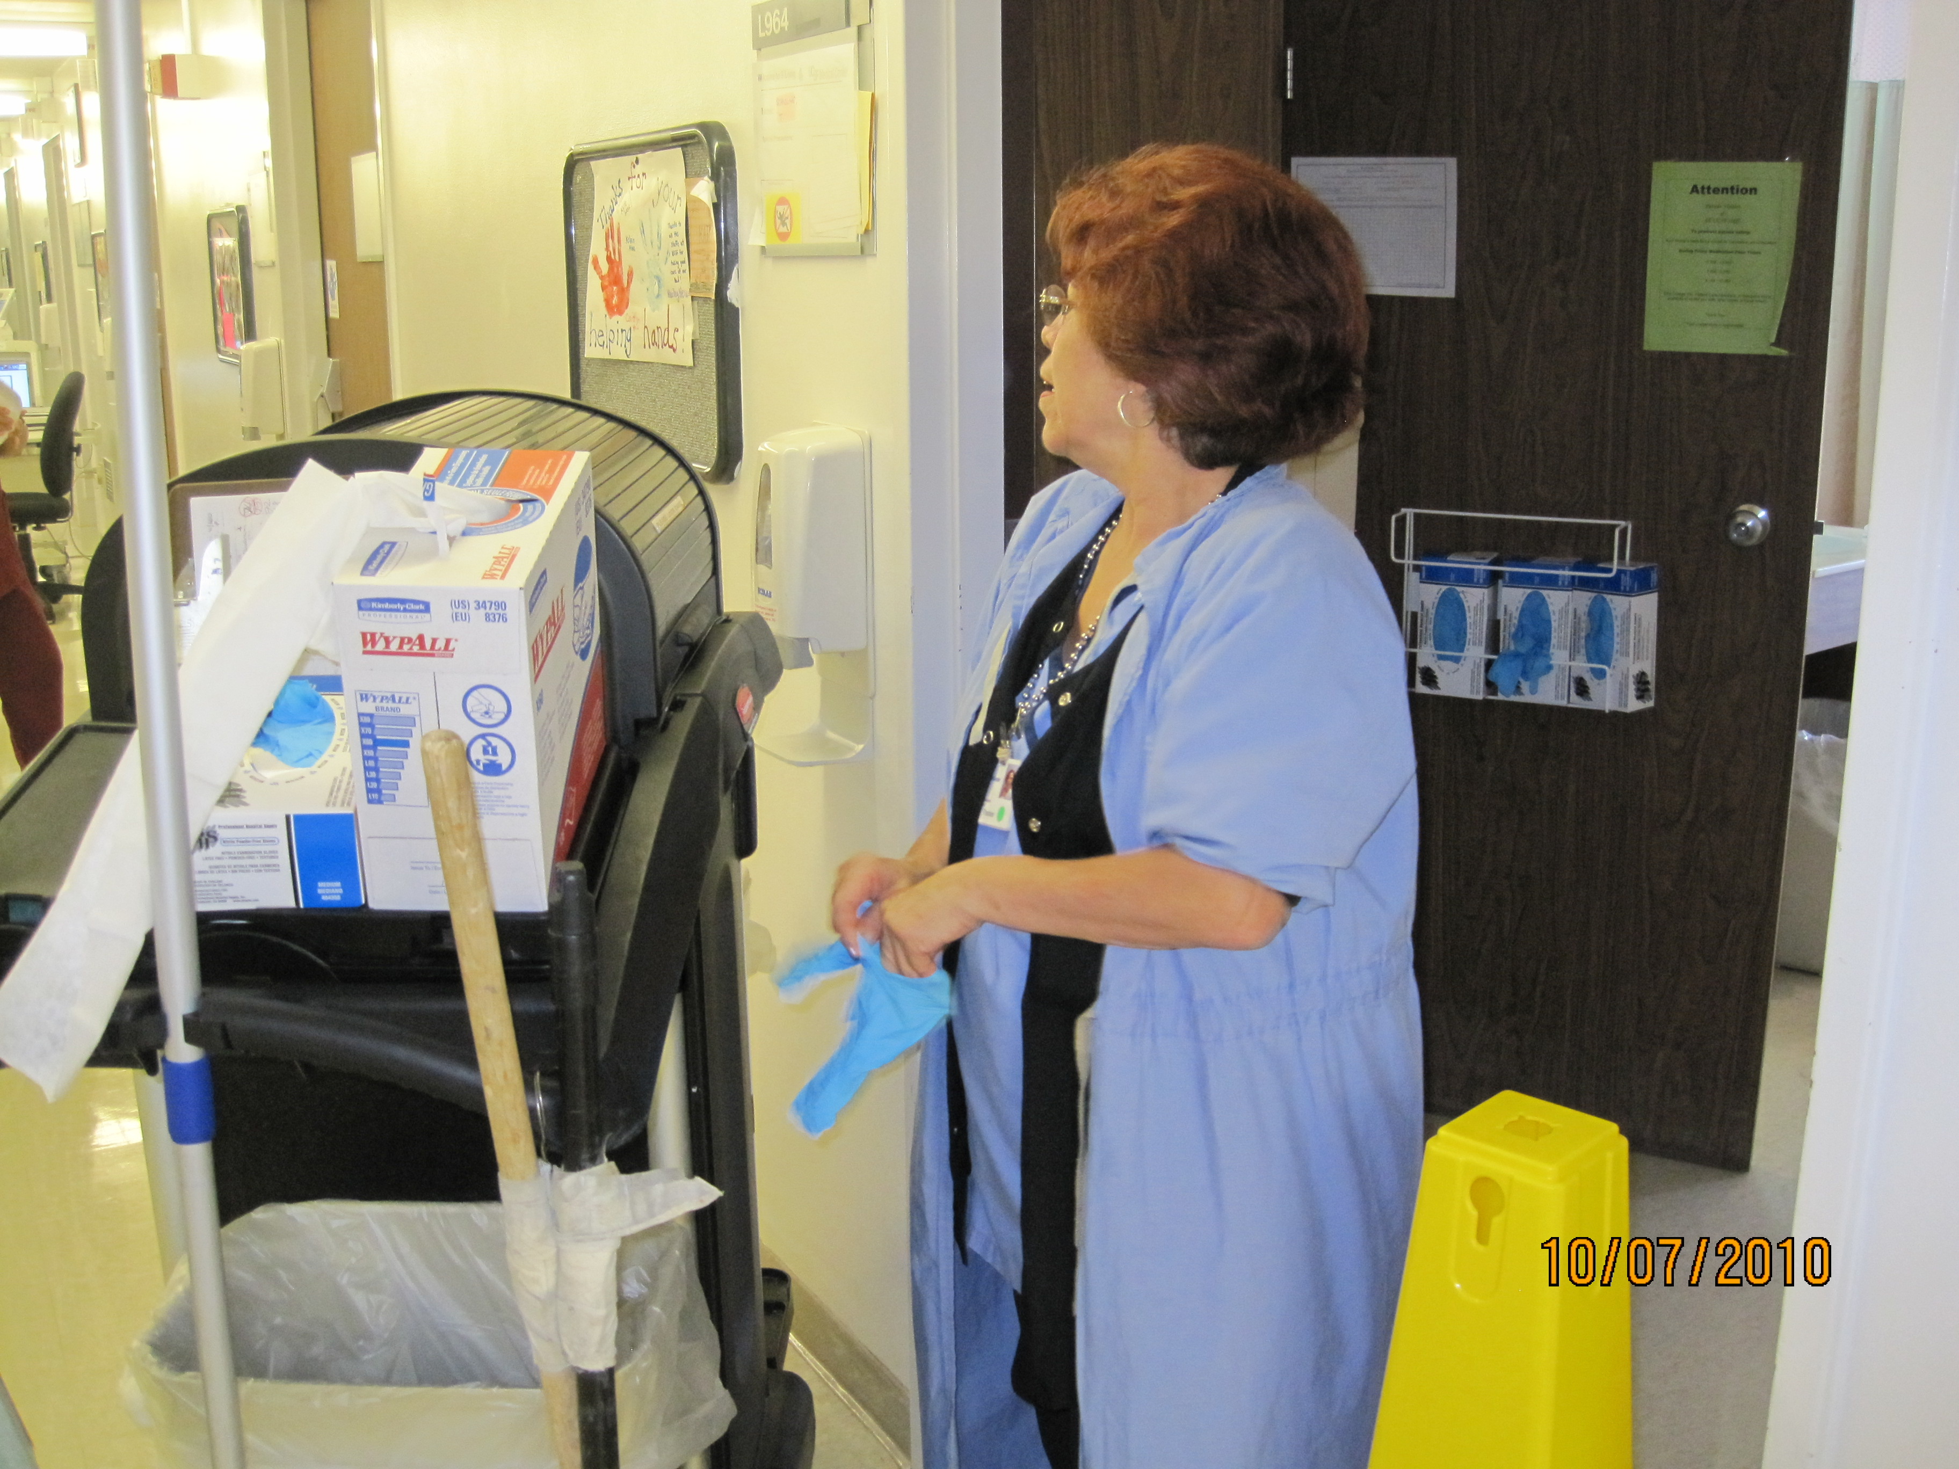
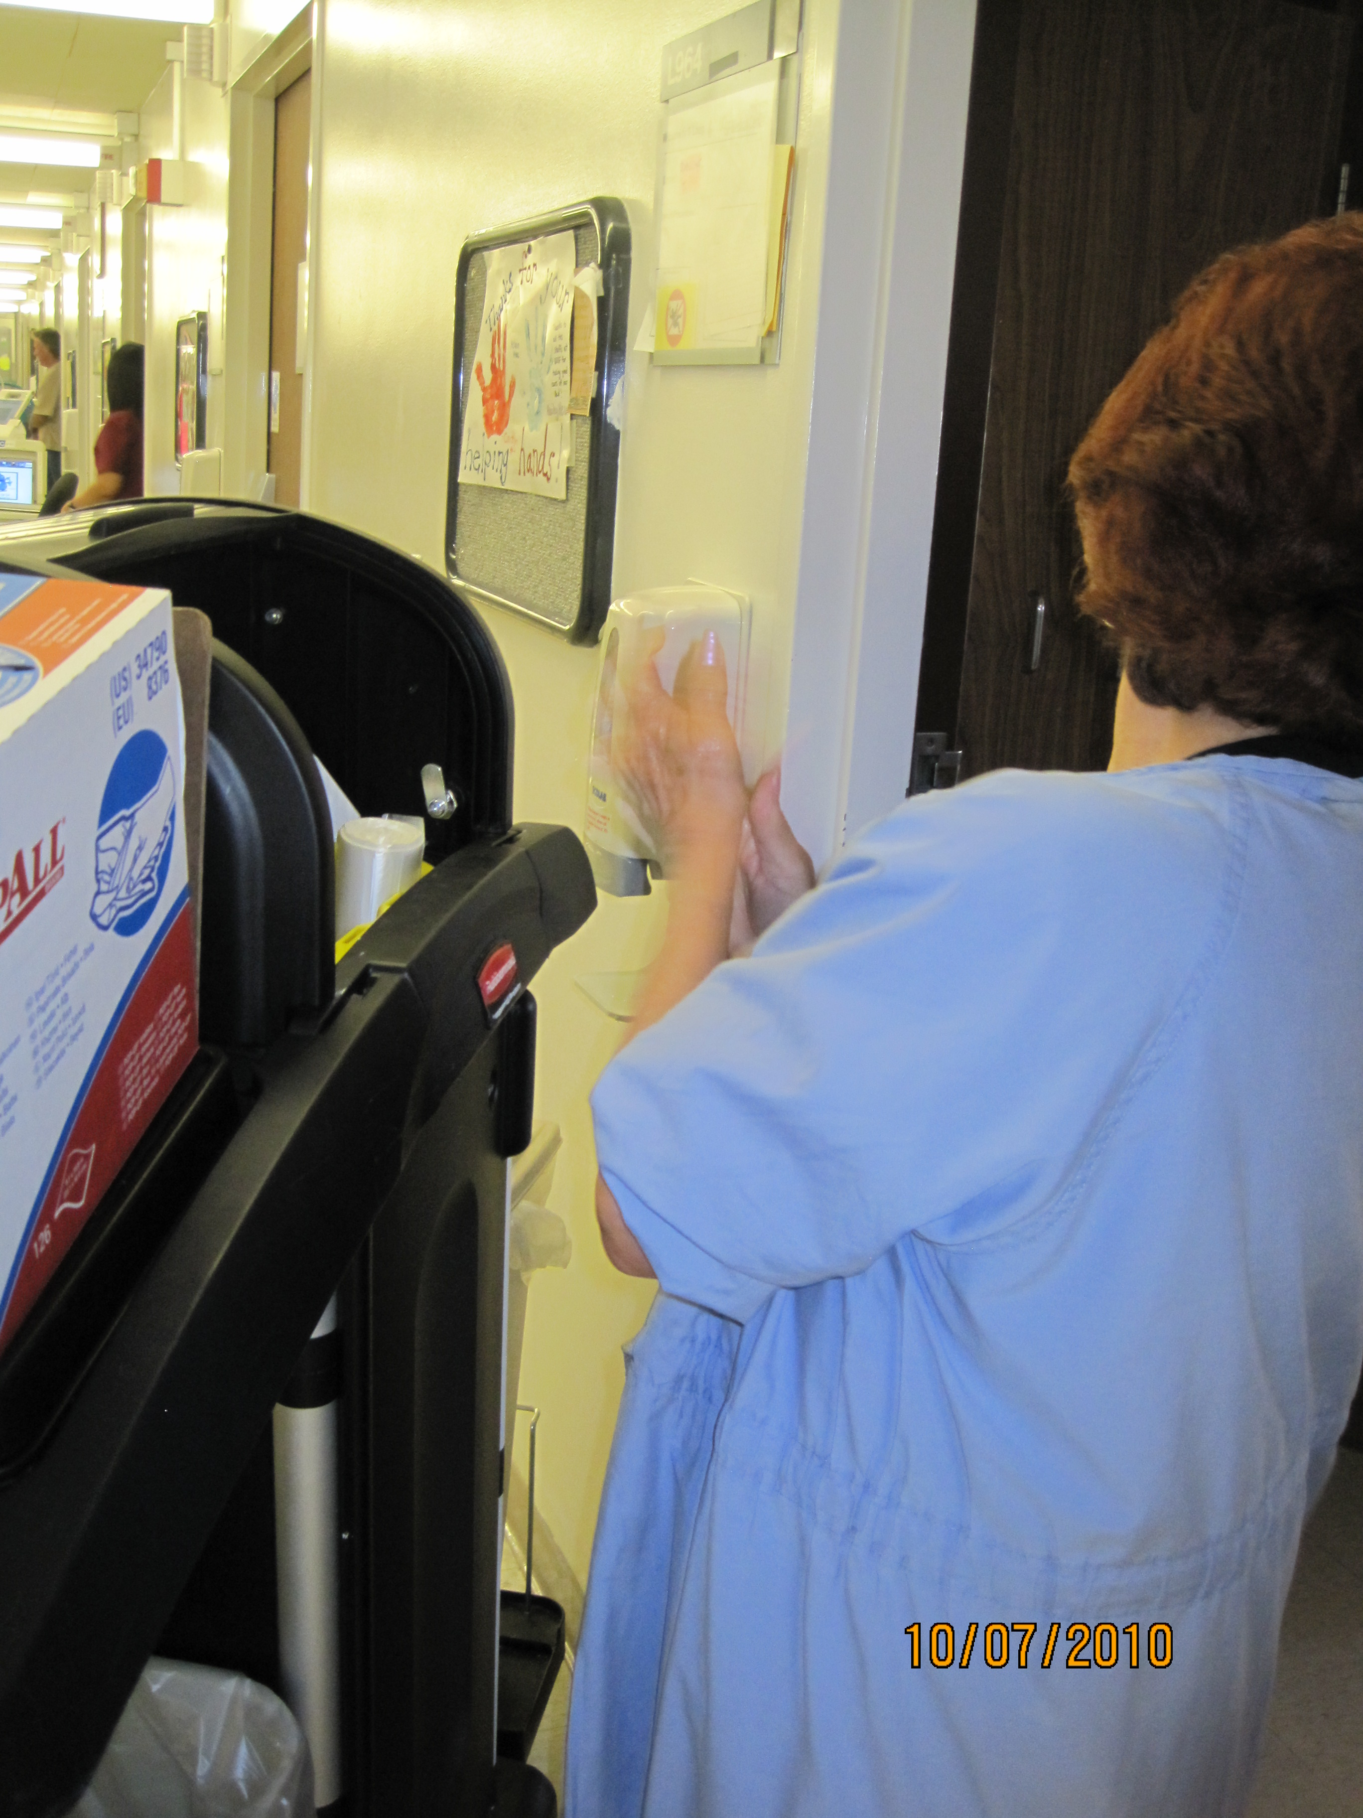
Hospitality (2)
Remove gloves
Clean hands

Slide 24
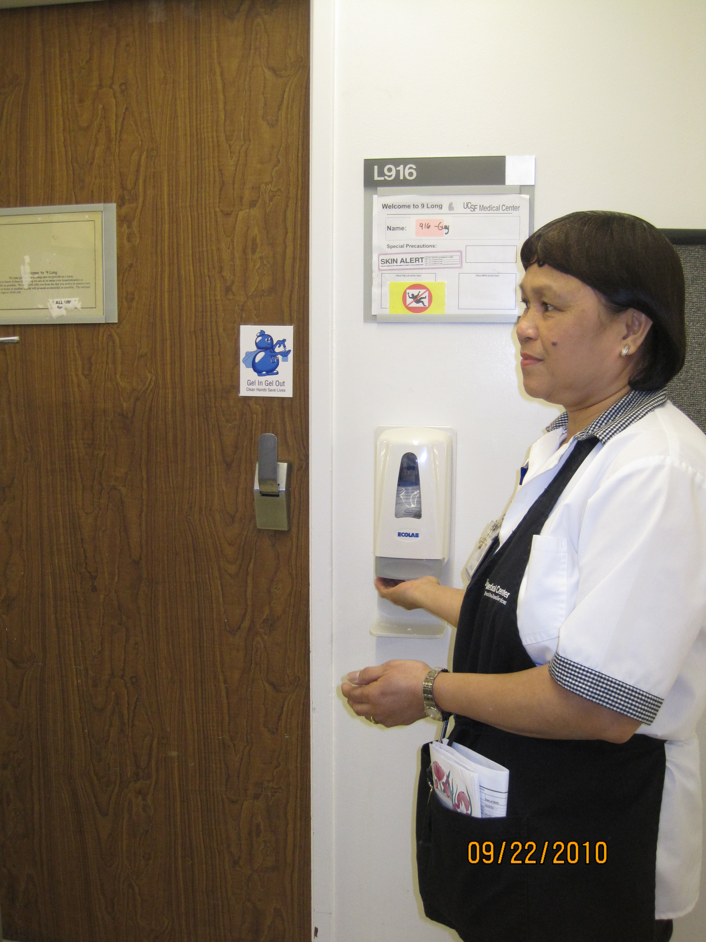
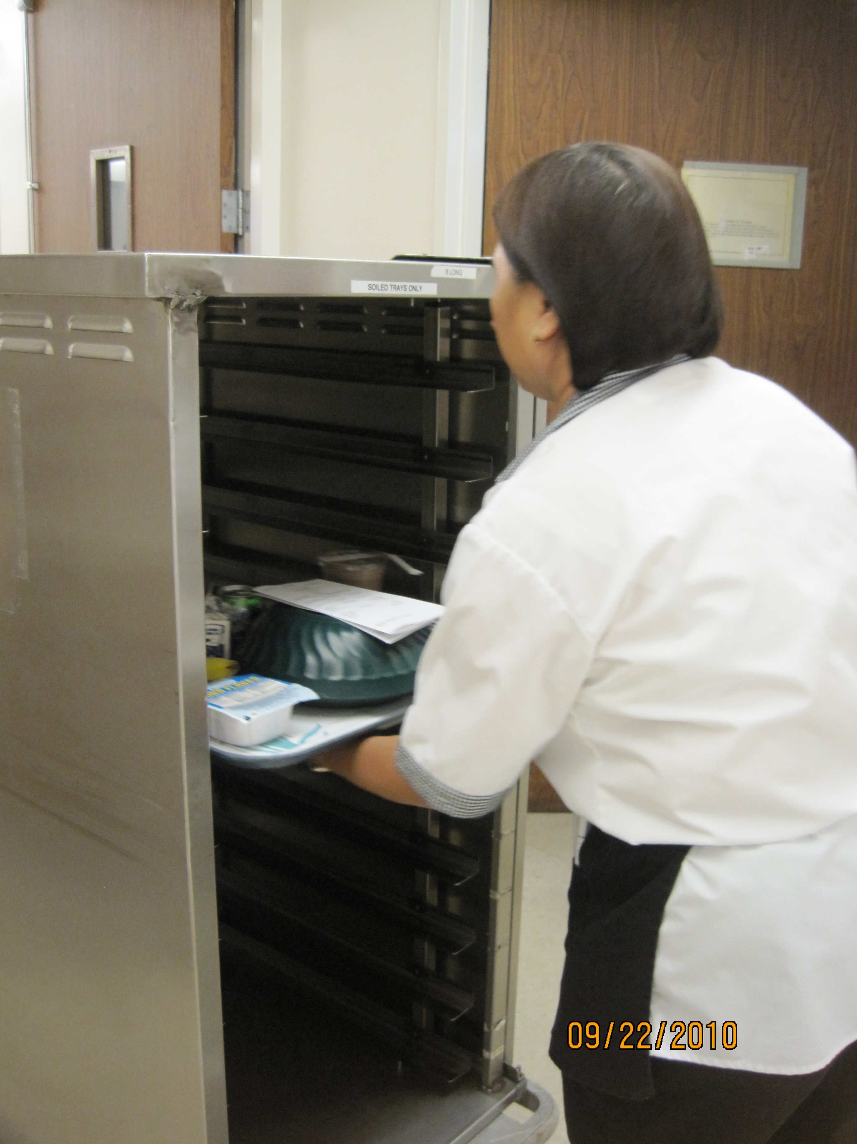
DELIVERY:
Clean hands
Pick up tray
Enter room
Deliver to patient
Clean hands
Exit room
PICK UP:
Clean hands
Enter room
Pick up tray
Place in soiled cart
Clean Hands
August 2010
Nutrition and Food Services:
Patient Food Trays

Slide 25
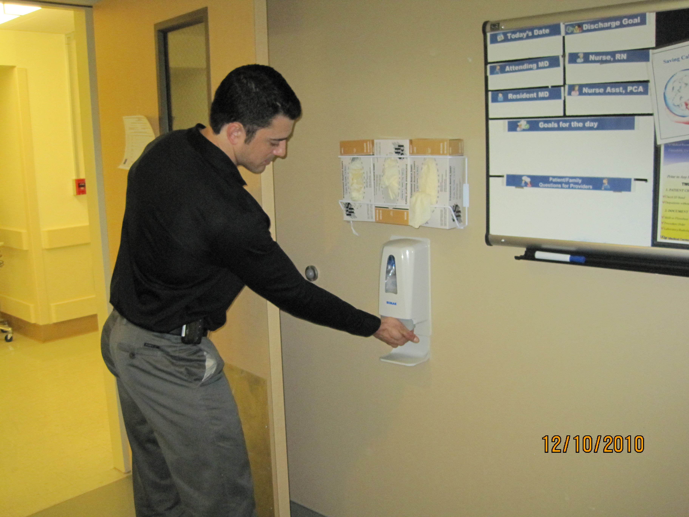
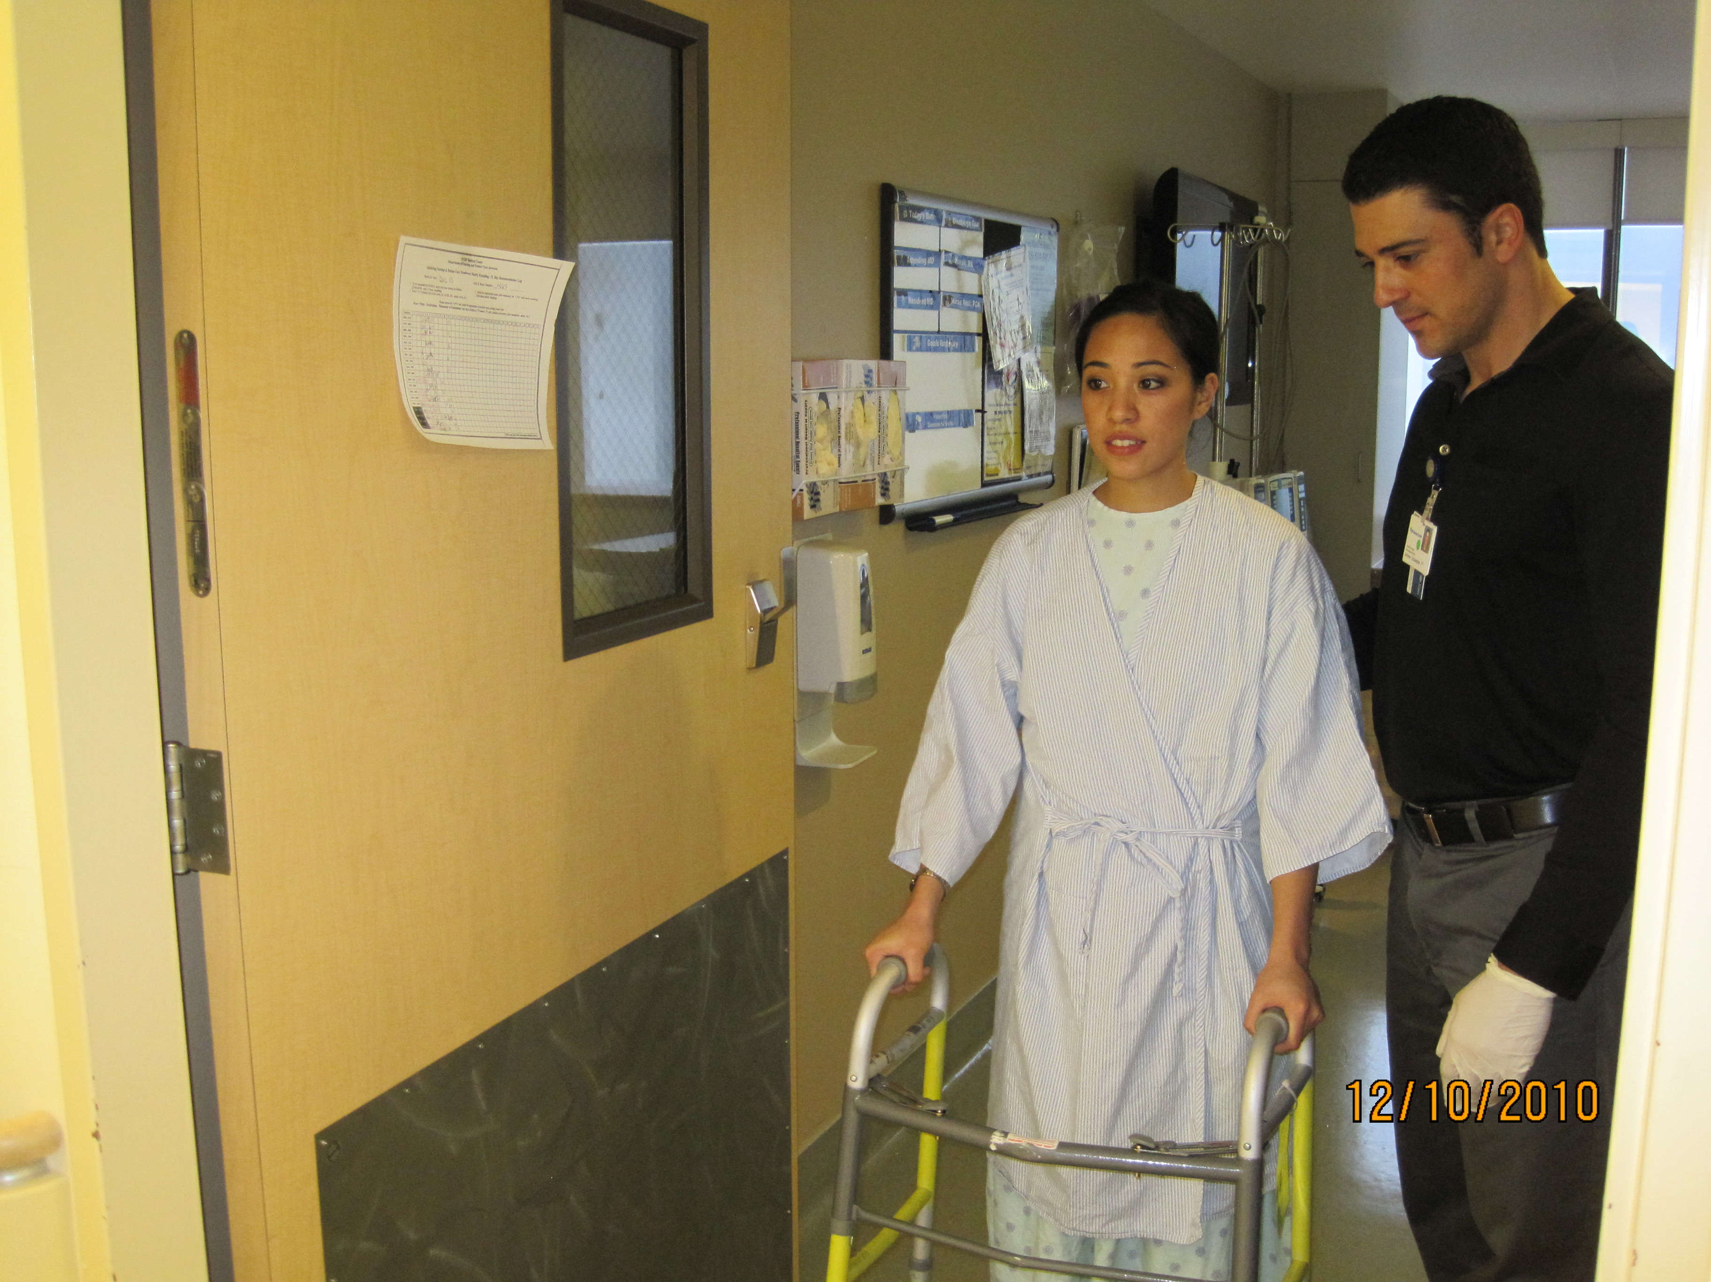
Rehabilitation Services (1)
Foam In
No hand hygiene required on exit with patient (“hands full”)
25

Slide 26
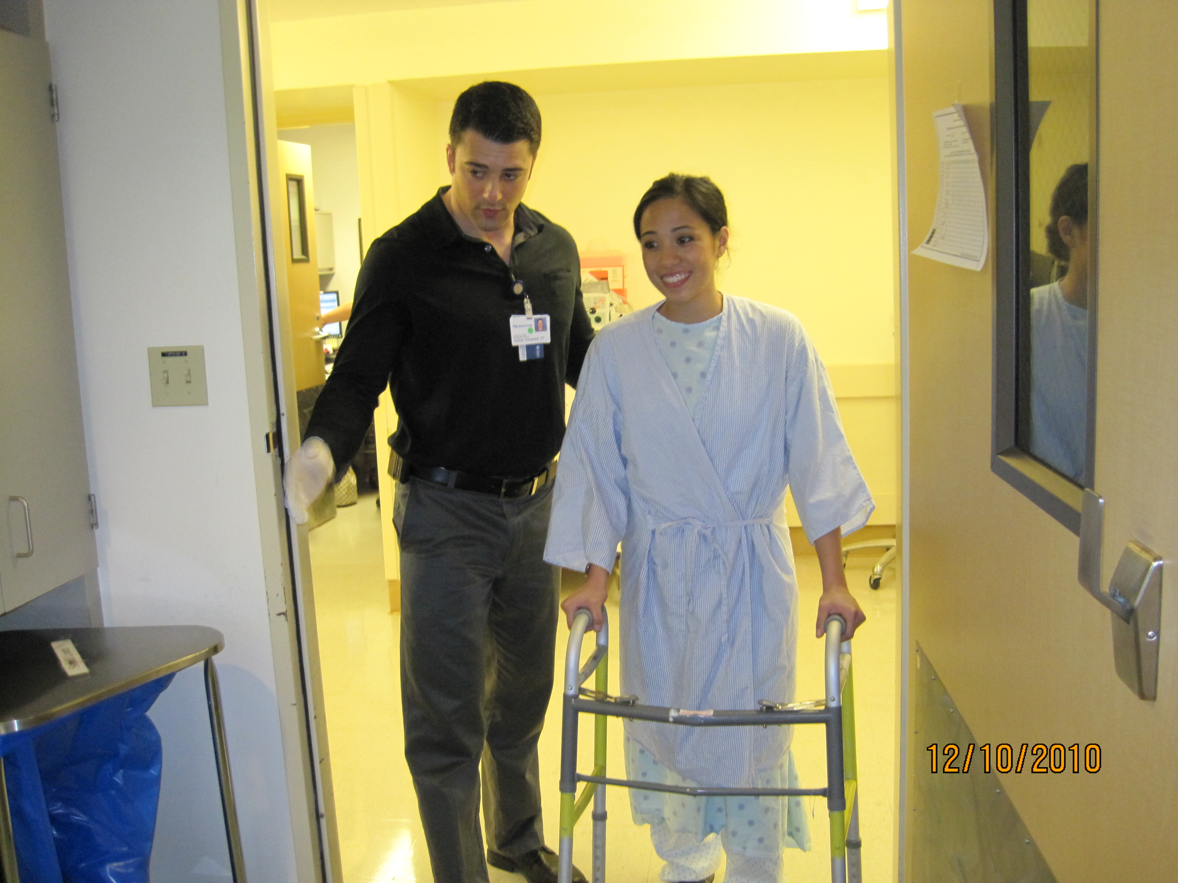
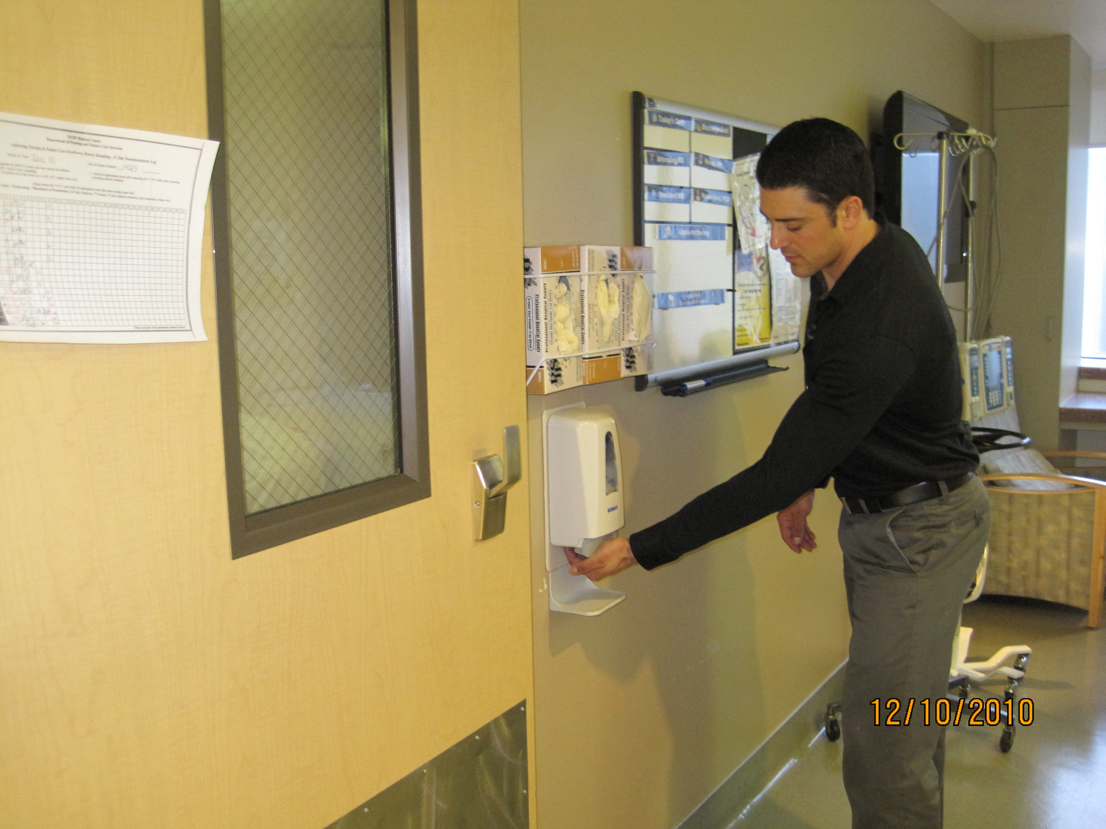
Rehabilitation Services (2)
No hand hygiene required when re-entering room with patient
Complete hand hygiene on final exit from patient room
26

Slide 27
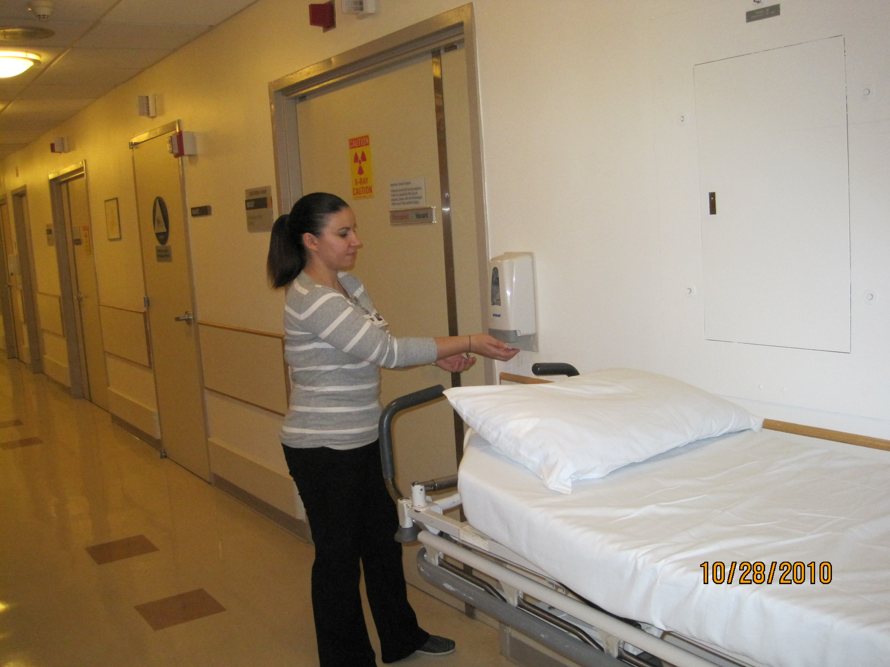
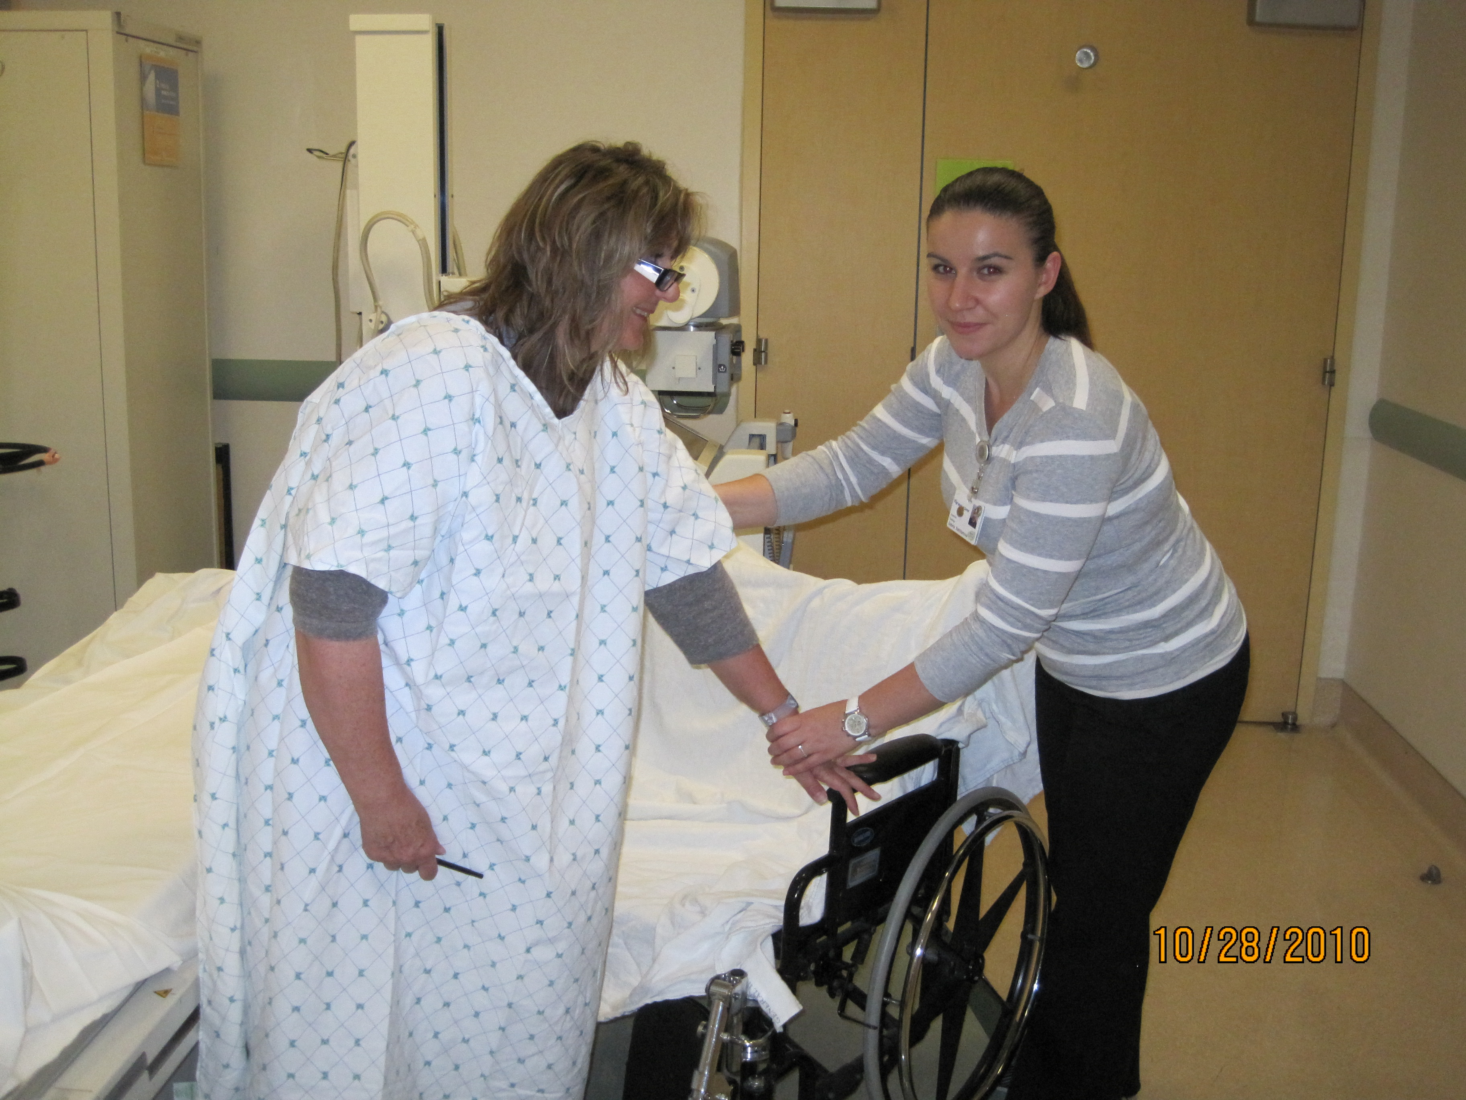
Foam in
Transportation Services (1)
Assist patient onto transportation vehicle
27

Slide 28
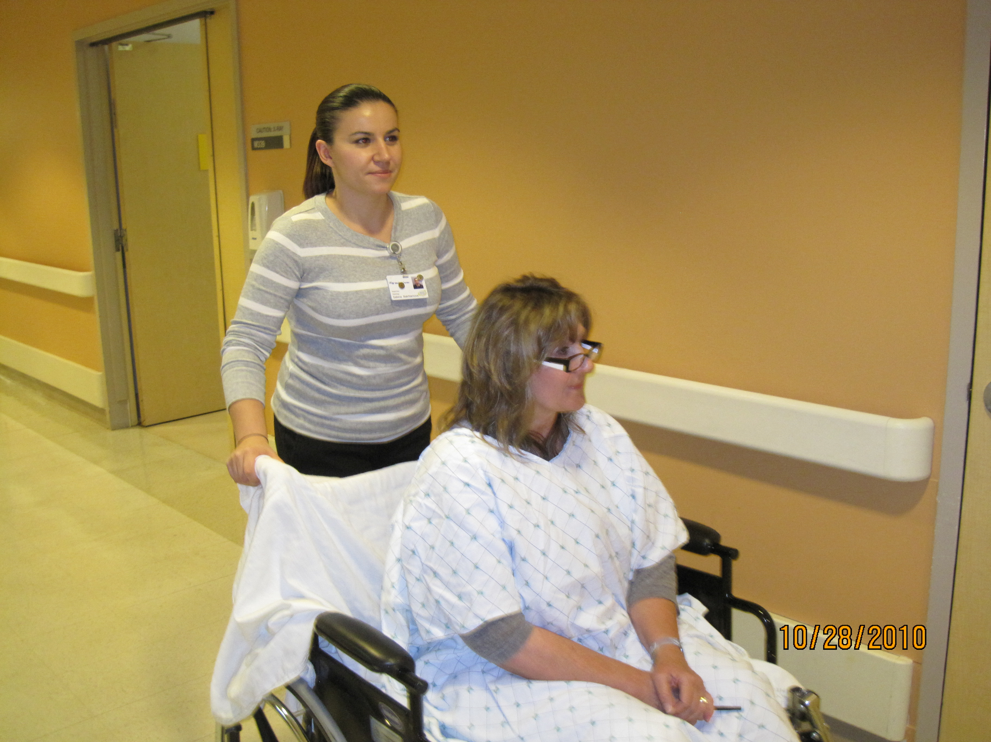
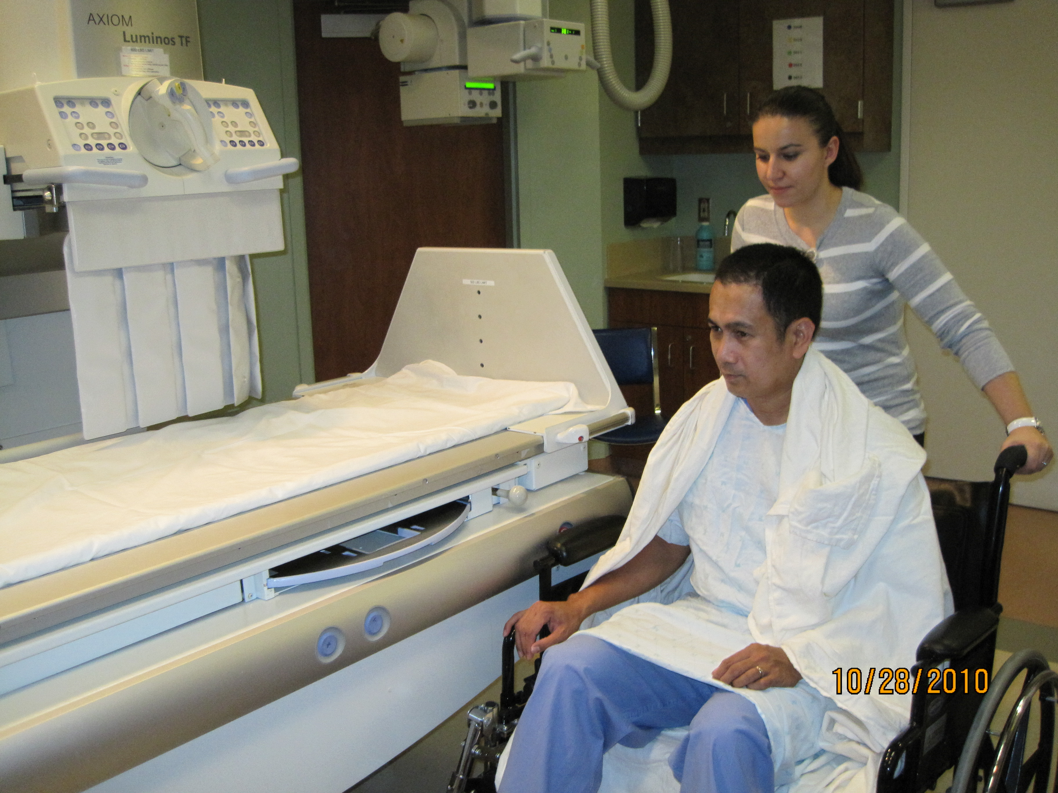
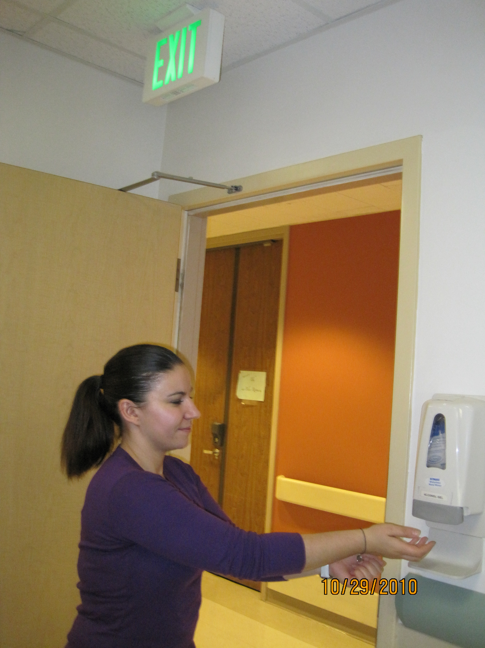
Transportation Services (2)
No gloves required for routine patient transport
Deliver patient to the destination
Clean hands upon exit
28

Slide 29

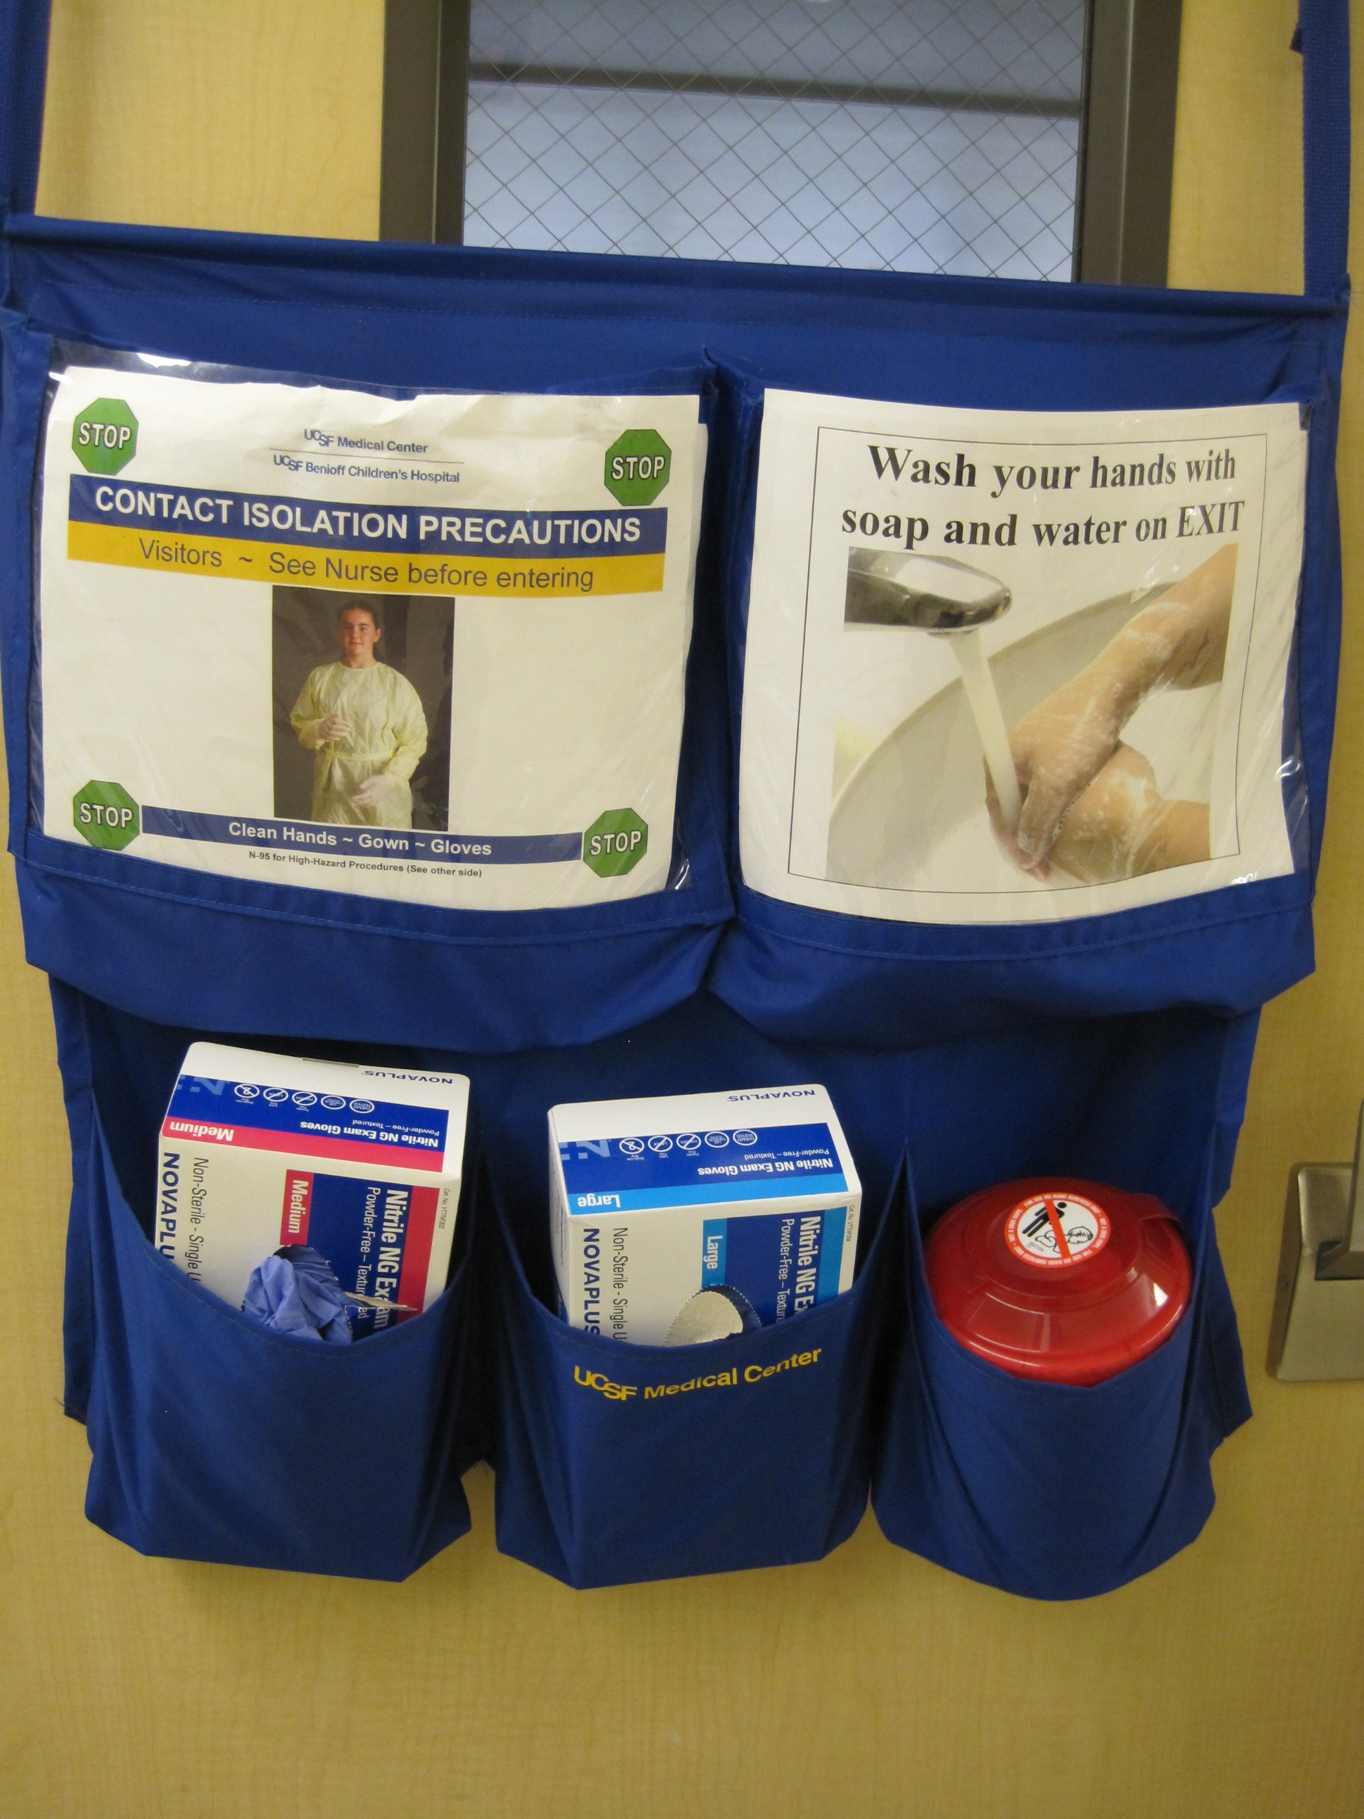
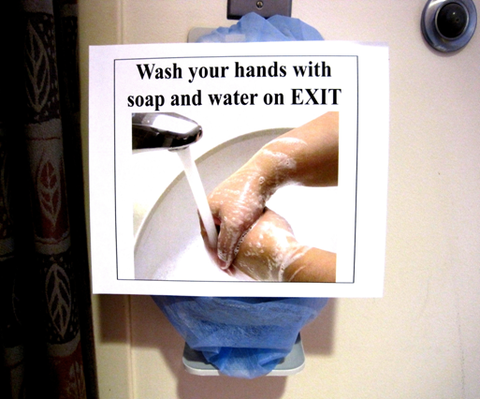
Enteric Contact Isolation
When is washing with soap and water required:
  Check door caddy for “Enteric Contact Isolation” with “Wash Your Hands with Soap and Water” signage
  Notice sign covers alcohol dispenser inside patient’s room

Slide 30
Enteric Contact Isolation:
Hand Hygiene and PPE
Correct sequence upon room entry
  Hand hygiene
    Alcohol foam or soap and water acceptable
  Put on PPE
Correct sequence upon room exit
  Remove and discard PPE in room
  Hand Hygiene:
    Wash with soap and water is the ONLY acceptable hand hygiene option

Slide 31
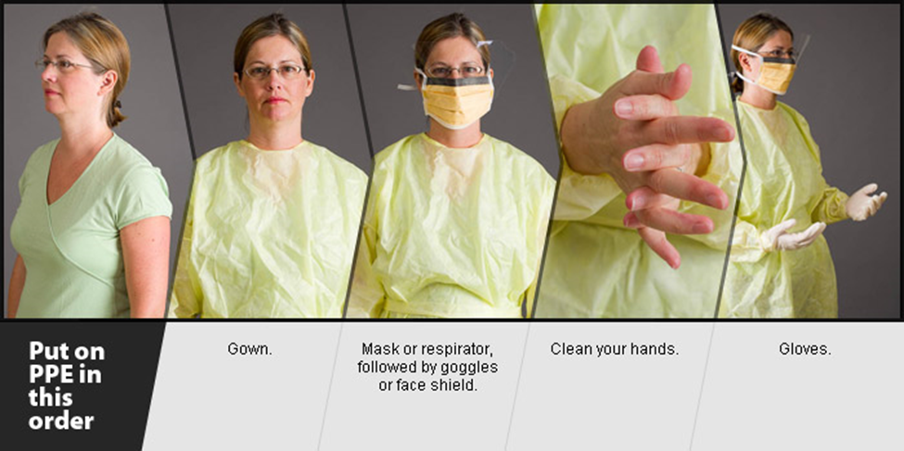
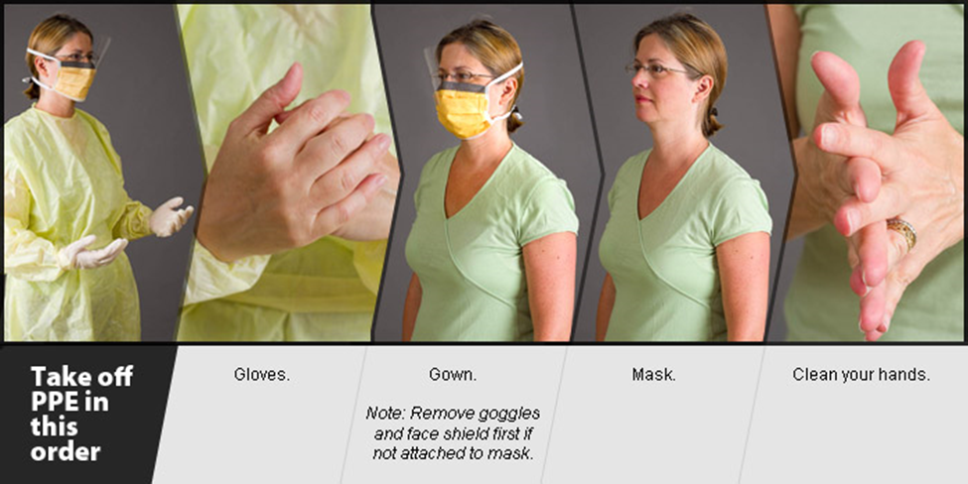
Proper Sequence for Hand Hygiene When Putting On and Taking Off PPE
Perform hand hygiene before donning gloves
Perform hand hygiene upon completion of removal of gloves, gown, mask, and eye shield

Slide 32
Scoring Compliance

Slide 33
Scoring Hand Hygiene Compliance for Contact Precautions
Example
Observer sees HCW exiting a patient room that has a door caddy with Contact Precautions and Wash with Soap and Water signage. The HCW goes directly to a sink to wash with soap and water.
  Score Yes for hand hygiene on Exit
Observer sees HCW exiting a patient room that has a door caddy with Contact Precautions and Wash with Soap and Water signage. The HCW uses the alcohol gel dispenser in the hallway.
  Score No for improper hand hygiene on Exit.

Slide 34
Scoring Hand Hygiene Compliance for Putting on and Taking off PPE
Example
Observer sees HCW enter a patient’s room while donning gloves without performing hand hygiene.
  Score No for improper hand hygiene on Entry
Observer sees HCW exiting a patient room and removing gloves, gown, mask, and eye protection. The HCW uses alcohol gel upon completion of removal of all PPE.
  Score Yes for hand hygiene on Exit
Observer sees HCW exiting a patient room and removing PPE. The HCW first removes gloves, performs hand hygiene, then finishes removing gown, mask, and eye shield. No additional hand hygiene is performed.
  Score No for improper hand hygiene on Exit

Slide 35
Hand Hygiene Compliance
Data Entry
Notes:
11/29/17 Reviewed, updated

Slide 36
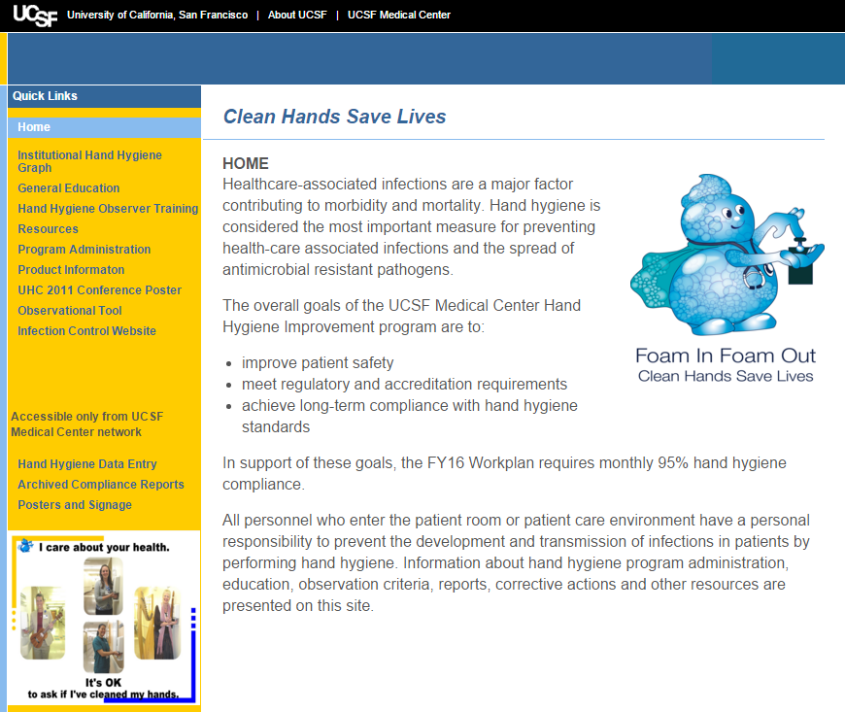
Cleanhands.ucsfmedicalcenter.org

Slide 37
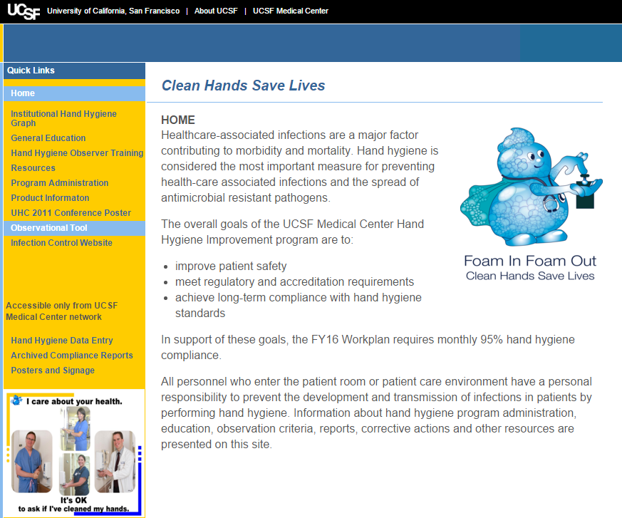
Observation Tool

Slide 39
Scoring Tips
Observe for 30 seconds after entry or exit for hand hygiene
  Do not enter an observation if you are uncertain if hand hygiene occurred
Each ENTRY and each EXIT is a unique observation
ONE hand hygiene opportunity may count as TWO observations:
  EXIT from one area followed by ENTRY to another area within 30 seconds of exiting the first area:
    Both can be compliant IF nothing has been touched
    Both can be noncompliant if no hand hygiene was done
  Record as:
    One EXIT from one area
    One ENTRY to the next area

Slide 40
Scoring Tips
Assign observations for students to their occupational category (e.g., RT students to RT)
Hand hygiene must be done after glove removal, including gloves worn for surgical scrub. Gloves do not substitute for hand hygiene!
Hand hygiene standards apply to empty patient care rooms, clean or soiled
All data must be entered by midnight of the last the month of observation
EXCLUSIONS:
Do not enter an observation of emergent situations (e.g., code)
Notes:
11/29/17 Reviewed, updated

Slide 41
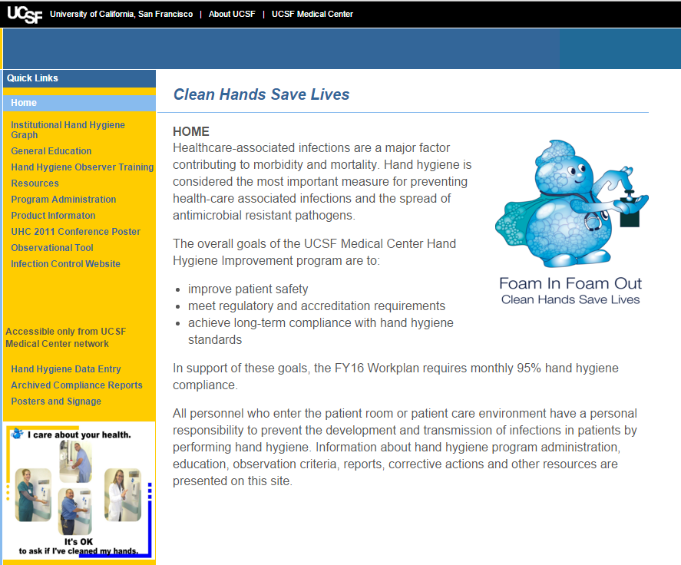
Access hand hygiene data entry here or go directly to
http://handhygiene.ucsfmedicalcenter.org

Slide 42
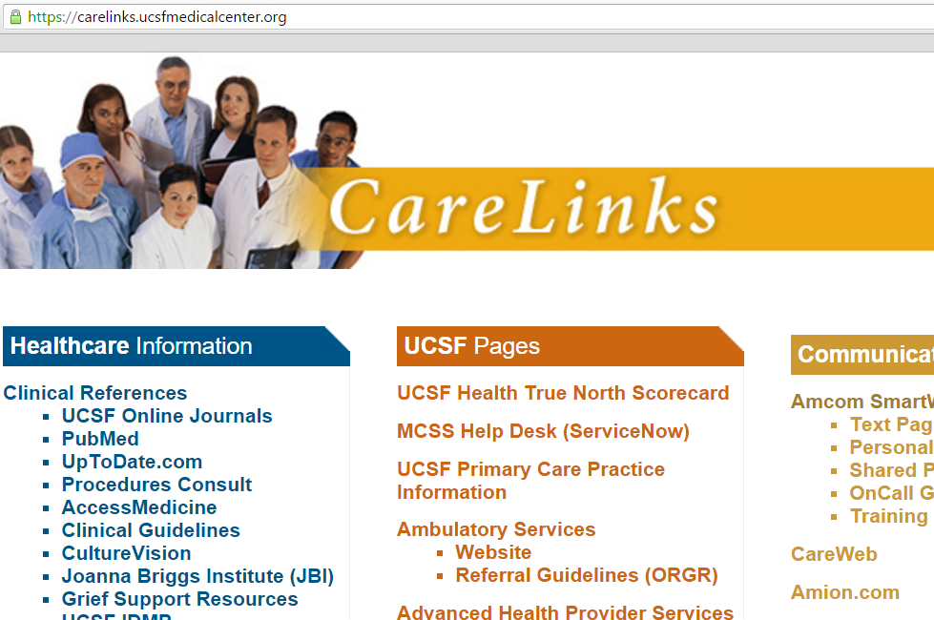
Or type https://handhygiene/
in the URL

Slide 43
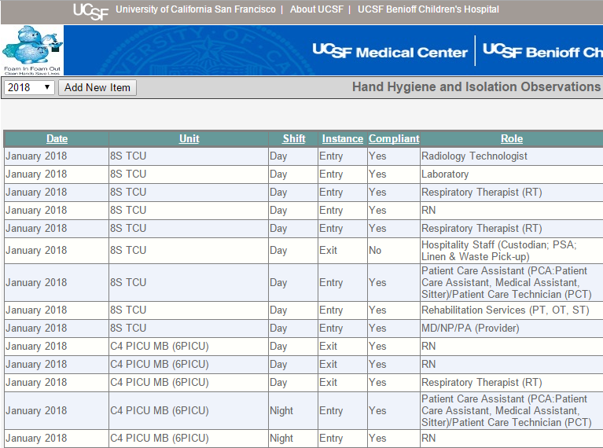
Click Add New Item for a new observation entry

Slide 44
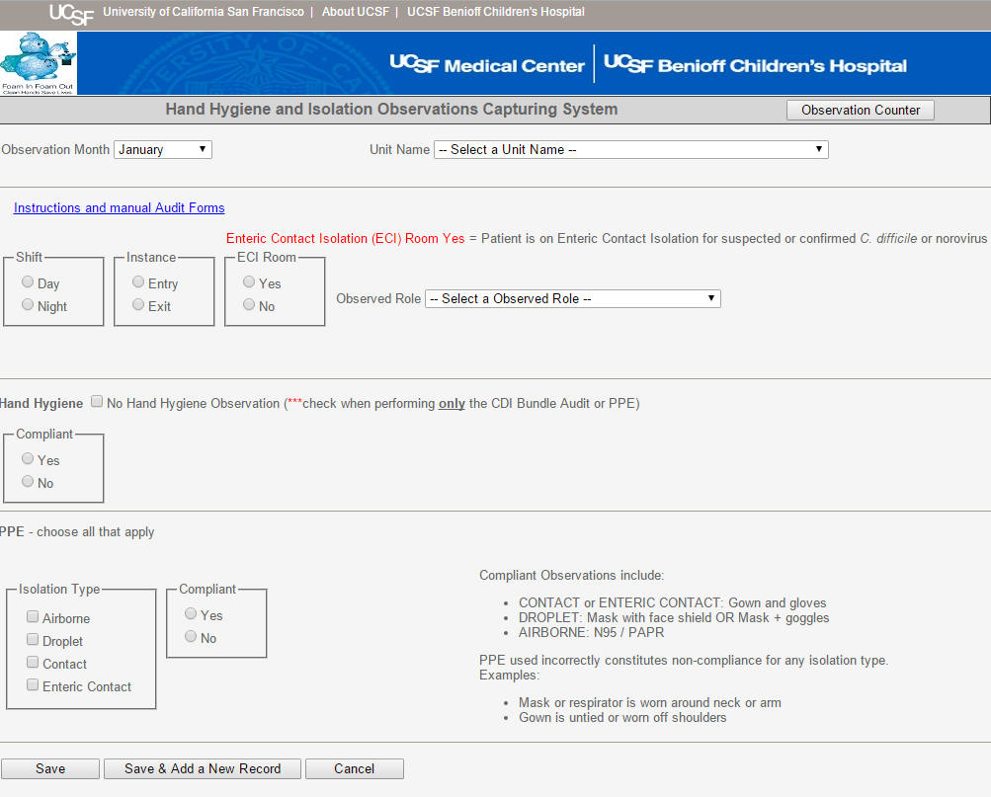
Defaults to current month
Select Unit
Enter Observations
Enter Observations
Enter circumstances
Select Occupational Group
Enter Observations
Enter Observations

Slide 45
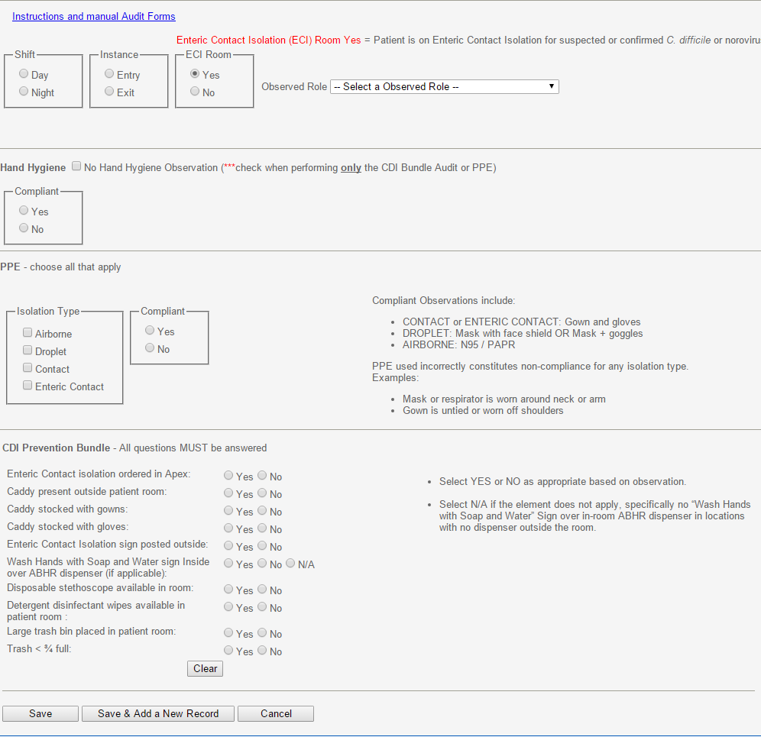
Enteric Contact Isolation Bundle
If pt is in Enteric Contact Isolation, click “Yes” ONLY if CDI Prevention Bundle data will be collected.
Soap and water on exit from the room is required for Hand Hygiene compliance.
Hand Hygiene observations do not require completion of CDI Bundle. Every data point helps, though!

Slide 46
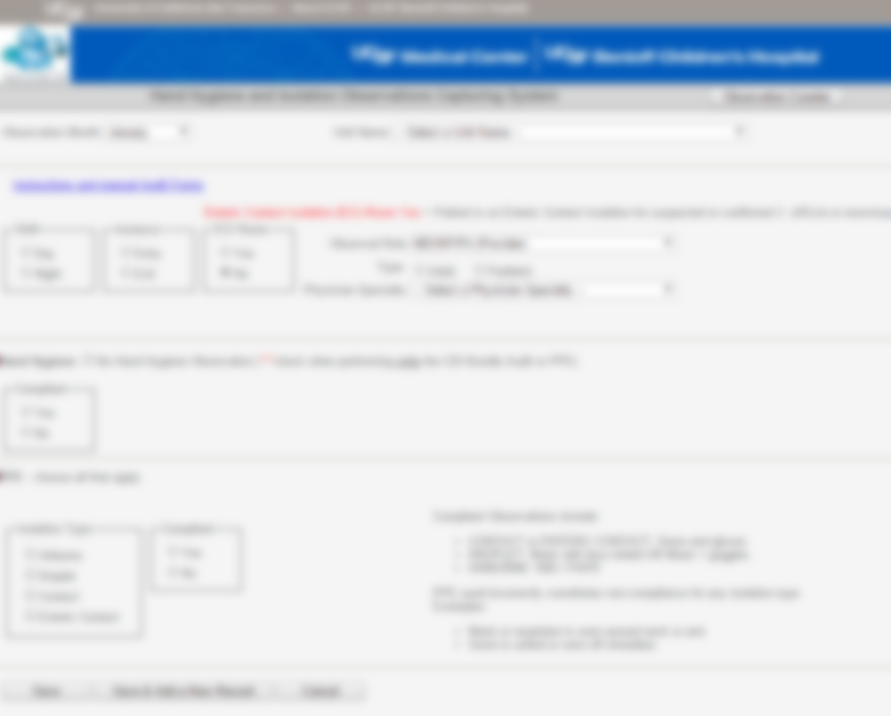
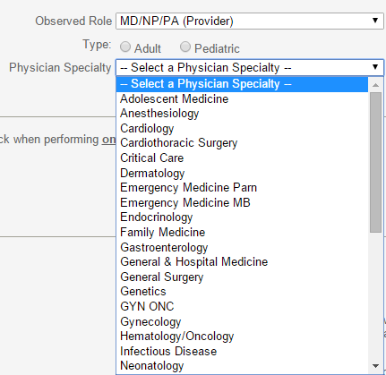
Provider Options
Choose “Adult” or “Pediatric”
Choose MD/NP/PA specialty
Ask MD/NP/PA their specialty

Slide 47

Click here to continue entering data for same unit, same month
Click Save to save individual record and return to home page

Slide 48
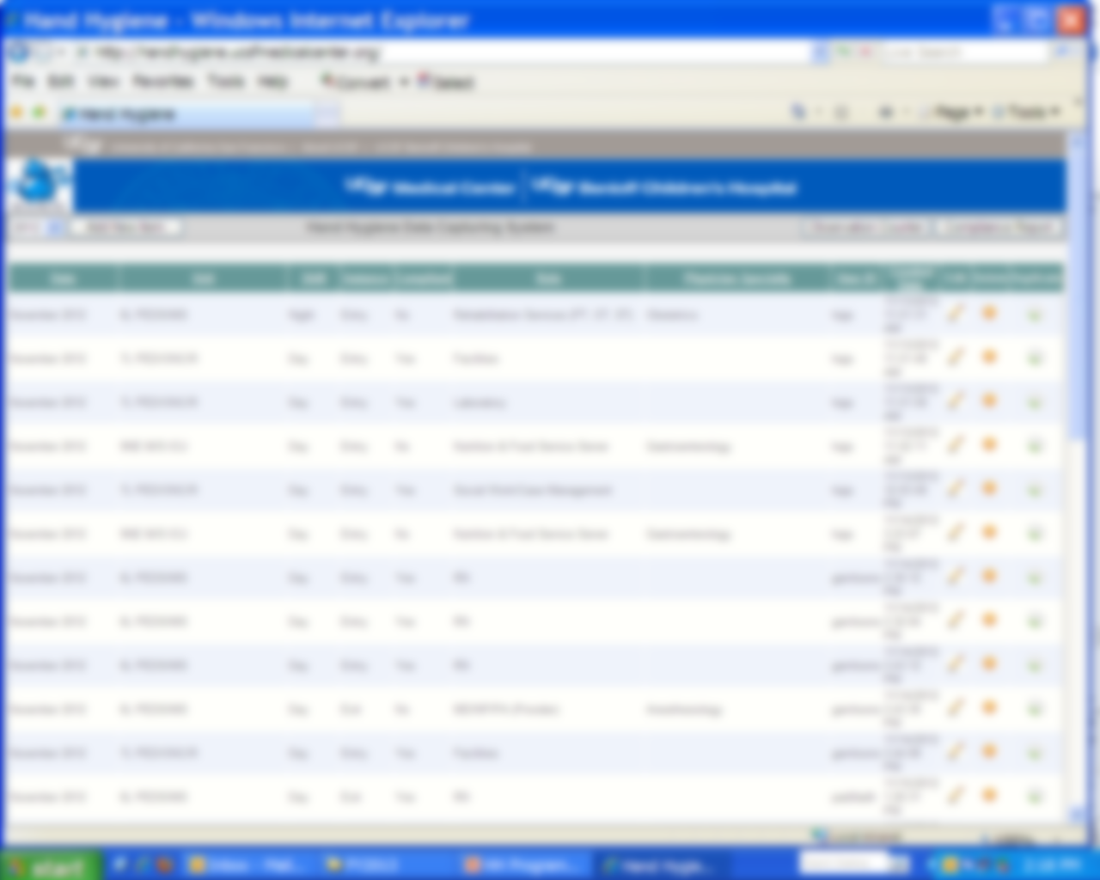

To edit, delete, or duplicate your own entries, click here

Slide 49
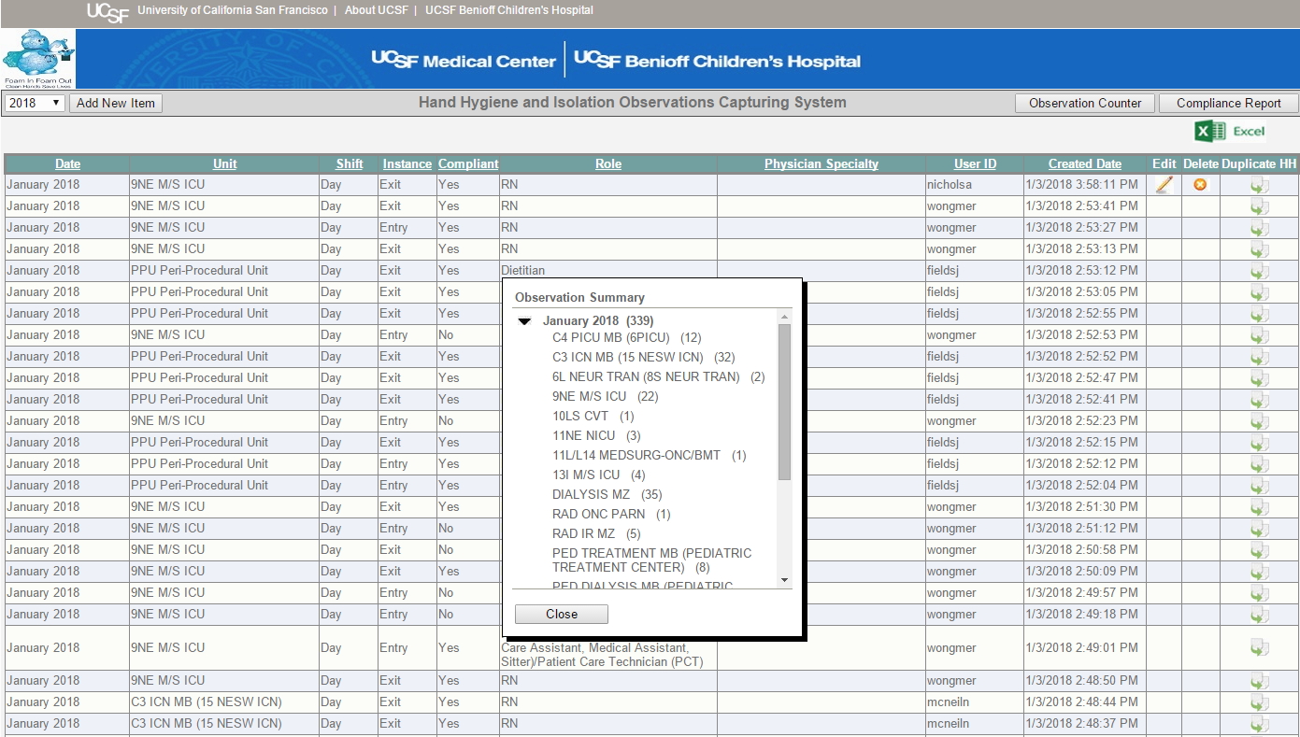

Sort for my unit’s entries
What is my unit’s compliance?
Export to Excel to Print Out Raw Data

Slide 50
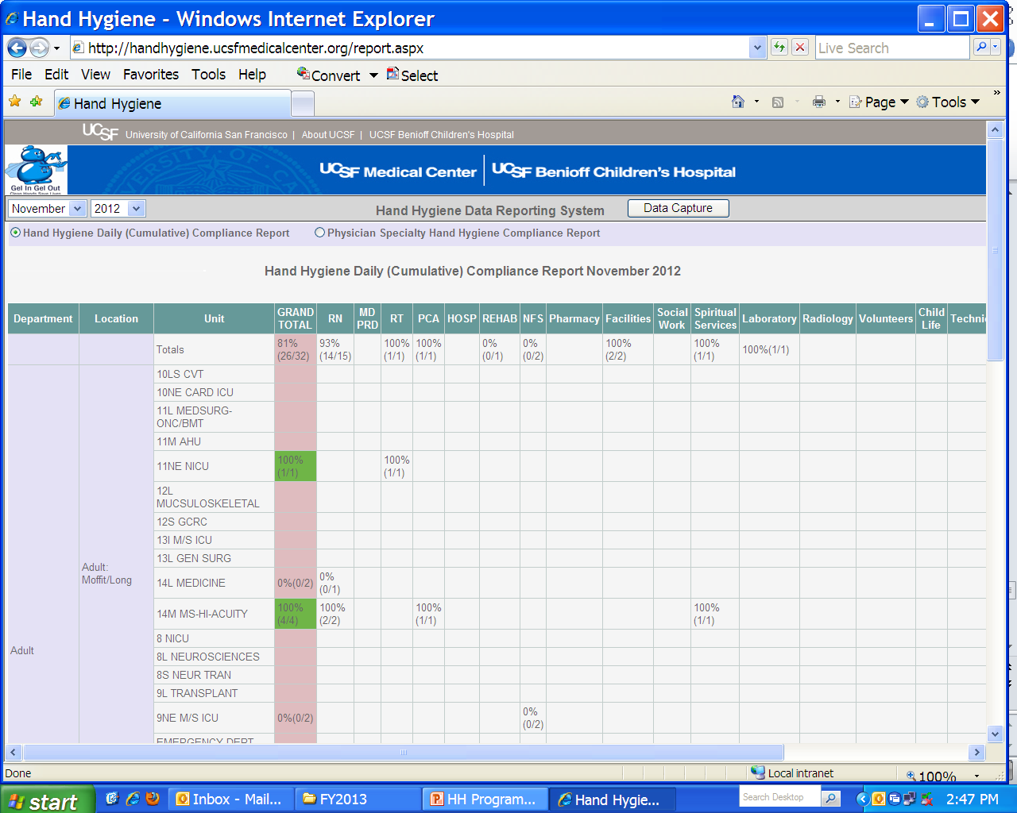
Compliance Results are Available Immediately After Data Entry

Slide 51
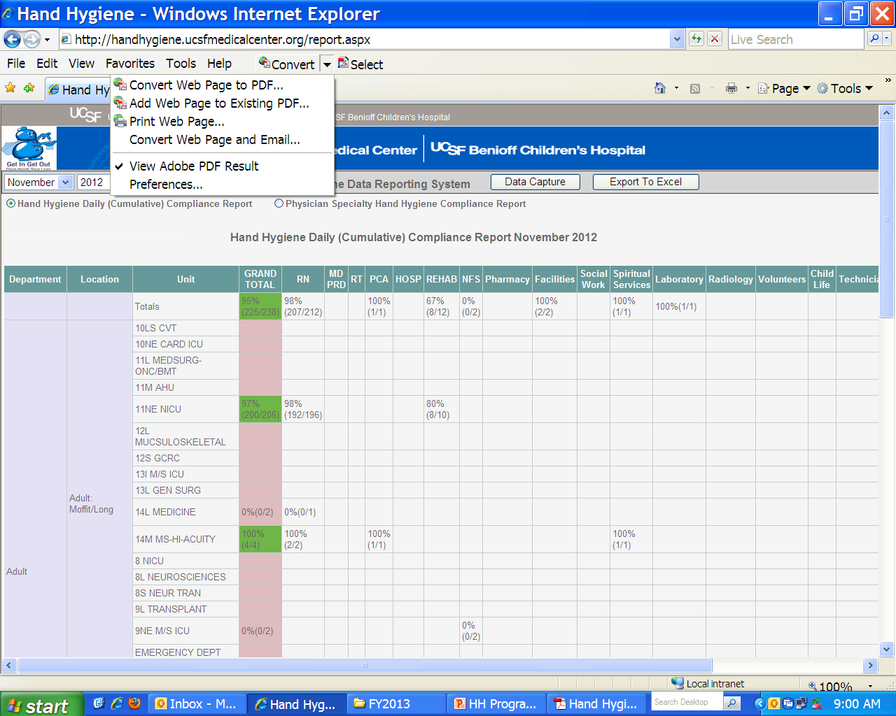
Or Click “Export to Excel”
Display and Print:
Click “Convert” then “Convert Web Page to PDF

Slide 52
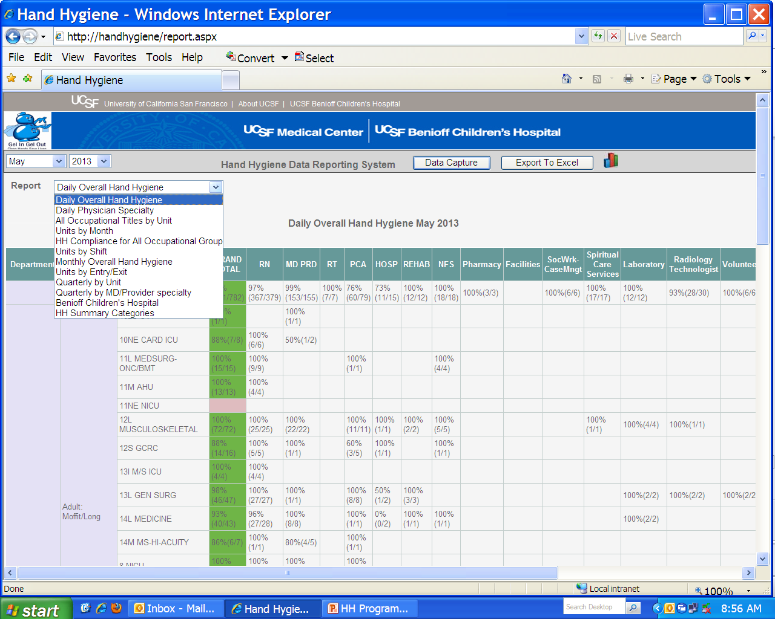
Click Here to Access Graphs
Click Here to Return to Home Page & Data Entry
Click the Drop-Down Arrow to Select Various Report Formats

Slide 53
Hand Hygiene
Just-in-time coaching

Slide 54
Purpose of JIT Coaching
Improve Culture of Safety at UCSF
  S = STOP the line; SPEAK up
    Personalized accountability
  T = Take time to ask, review, check
    What barriers caused imperfect hand hygiene?
    How can you help move toward perfect hand hygiene?
  O = Optimize communications, community-building
    Learn each others’ names, roles, responsibilities
    Learn how to help each other succeed
  P = Push unresolved issues upward toward resolution
    Impact the journey to excellence

Slide 55
Hand Hygiene
Corrective Action
Notes:
11/29/17 Reviewed, updated

Slide 56
Corrective Actions
Key Elements
  Post Data in Highly Visible Location
  Discuss results in regular staff meetings
  Demonstrate strong leadership support
  Educate
  Behavioral Contracting
  Reminder Cues (visual signage and words)
  Just-In-Time Coaching***

